Slide 1

Happy Families? Convergence, Antagonism and Disciplinary Identity.
or ‘We’re all God knows what now’ (Cook 2016)
City University London Debate
1st June 2016
Laudan Nooshin, City University London

Slide 2
  One-day Conference of the British Forum for Ethnomusicology, Royal Holloway College, 17th November 2001
  ‘…it ended by saying, well, if we are all ethnomusicologists now, there is no difference between musicology and ethnomusicology, so why don't we just say we are all musicologists now. However, when I came to write it up for Henry's book I cut that: I decided it was open to interpretation as musicological hegemony and blunted rather than sharpened the main argument. I changed the title to ‘We are all (ethno)musicologists now’ at a late stage of book production, reflecting the brackets in the book’s title.’ (Nick Cook, personal communication, May 2016)

Slide 3
In the beginning ….
An occupied musicology?

Slide 4
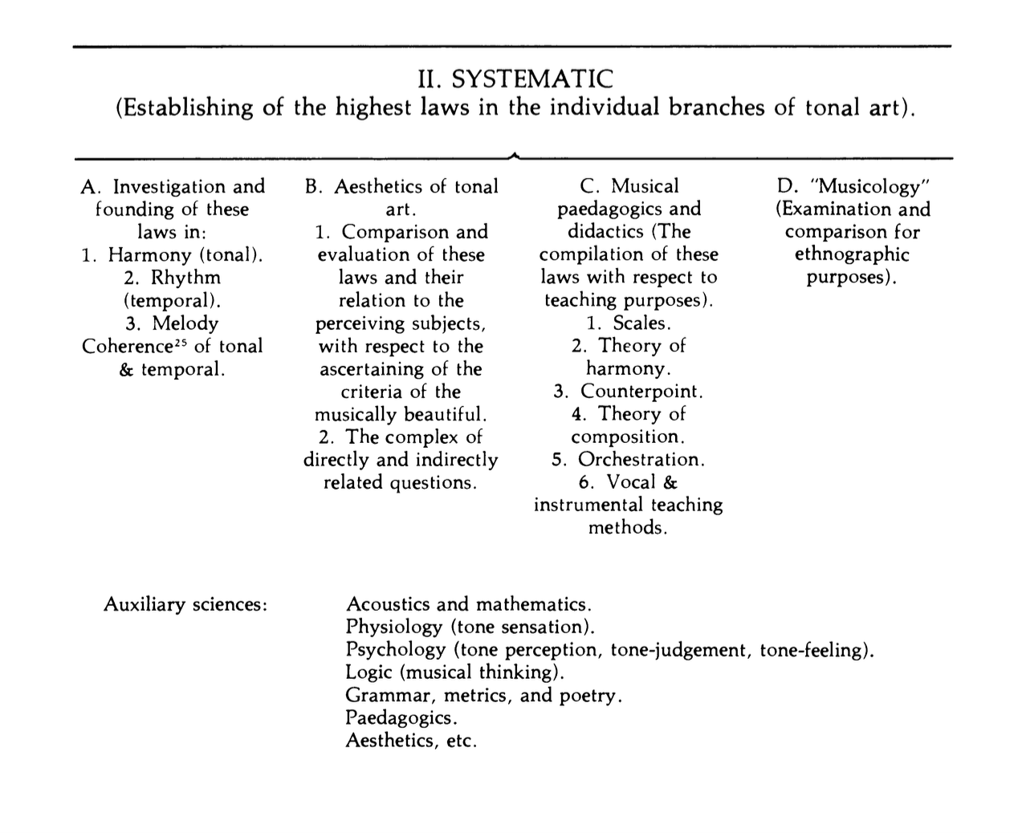
Guido Adler’s "The Scope, Method, and Aim of Musicology" (1885): An English Translation with an Historico-Analytical Commentary, Erica Mugglestone and Guido Adler, Yearbook for Traditional Music, 13 (1981), pp. 1-21.

Slide 5
  ‘We patently are not all ethnomusicologists now, because still none of us know exactly what that is. If it means doing anthropological-style fieldwork, then very few of our WAM colleagues do that kind of work, not even when they work on contemporary music. So no. If it means thinking about music in/as culture/al context, then WAM history colleagues have been doing that for a long time anyway, especially the new cultural historians inspired by Clifford Geertz etc., and let’s be frank: that’s not really what (has ever) distinguishes(d) ethnomusicology. So no. If it means recognising all the non-Western sounds and activities that ethnomusicologists study as legitimately ‘music’ and worthy of study in music departments, then still no; there’s still a lot of snobbery around.’

Slide 6
‘I’m an ethnomusicologist not because I study the non-west, or culture or something. I'm an ethnomusicologist because I studied with Ruth Davis and Henry Stobart. I submit grants to do research that involves ethnography and think I should know the local language. I go to BFE and SEM, and I hang out with Rachel Harris, Caroline Bithell, Laudan Nooshin, and co. I read Ethnomusicology Forum and I have Shadows in the Field, Jennifer Post's book and an old edition of Nettl on my bookshelf alongside a ton of anthropology theory.’

Slide 7
Back to 2001 …
Spot the difference?
‘I call myself different things (ethnomusicologist, musicologist, music scholar) depending on the context (conference, teaching, country, fieldwork) and my audience, since these terms have very different meaning (or little meaning) to different people. Personally the label is not so important to me. My research and teaching has been shaped by my ethnomusicological training. But my research, in terms of methodologies and the literature I draw on, is motivated more by the specific research questions I am pursuing and less by (sub)disciplines they may be associated with.’

Slide 8
Where we’re at …
‘I don’t see many musicologists producing fine-combed ethnographies, or even doing extended, in-depth fieldwork.’
‘I think there's actually very little engagement between the two; and scholars on both sides seem to have some rather stereotyped assumptions about the other.’

Slide 9
‘… a new generation of scholars emerging for whom this is not an identity issue; having studied a diversity of musics as undergraduates it seems quite obvious and natural to draw on these different resources and methods.’
‘I think there are two new convergences, between: a) musicologists and ethnomusicologists who are interested in how music mediates culture; and b) the “new empiricists” (big data, music and science/cognition, new music analysis, etc).’

Slide 10
‘According to ethnomusicology, the cultures of the non-western world should take intellectual precedence, and those of us who spend our time focusing on Western [classical] music should feel ashamed of ourselves (there is quite an irony in the fact that ethnomusicology, in the UK at least, increasingly attempts to colonize the Western-music syllabuses of our universities).’
J.P.E. Harper-Scott (2012) The Quilting Points of Musical Modernism: Revolution, Reaction, and William Walton. Cambridge University Press. pp. 251.

Slide 11
‘I think that reflexivity over sub-disciplinary boundaries or identities is worthwhile, but for it spill over into animosity is a dangerous step in a climate in which serious thinking about music has little support outside academia … It’s easy to find ways in which other people’s scholarship on music doesn’t measure up in some way to our own standards; better would be to think more about how the best of musicology can enrich ethnomusicology and vice versa.’

