Slide 1
‘The Elephant and the Blind Men: Myth-Making, Tracking and Musical Creativity’
Keynote paper for the conference:
‘Tracking the Creative Process in Music’
University of Huddersfield, 14th to 16th September 2017
Laudan Nooshin, City, University of London

Slide 2
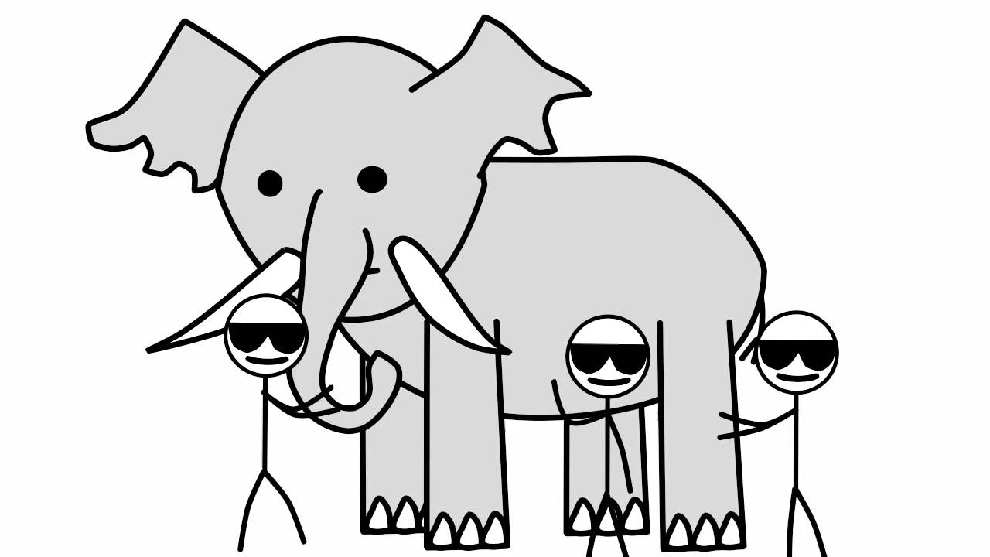
Tracking the Elephant

Slide 3
musiqi-e assil
bedāheh-navāzi (improvisation)
āhang-sāz (composer)
dastgāh Segāh

Slide 4
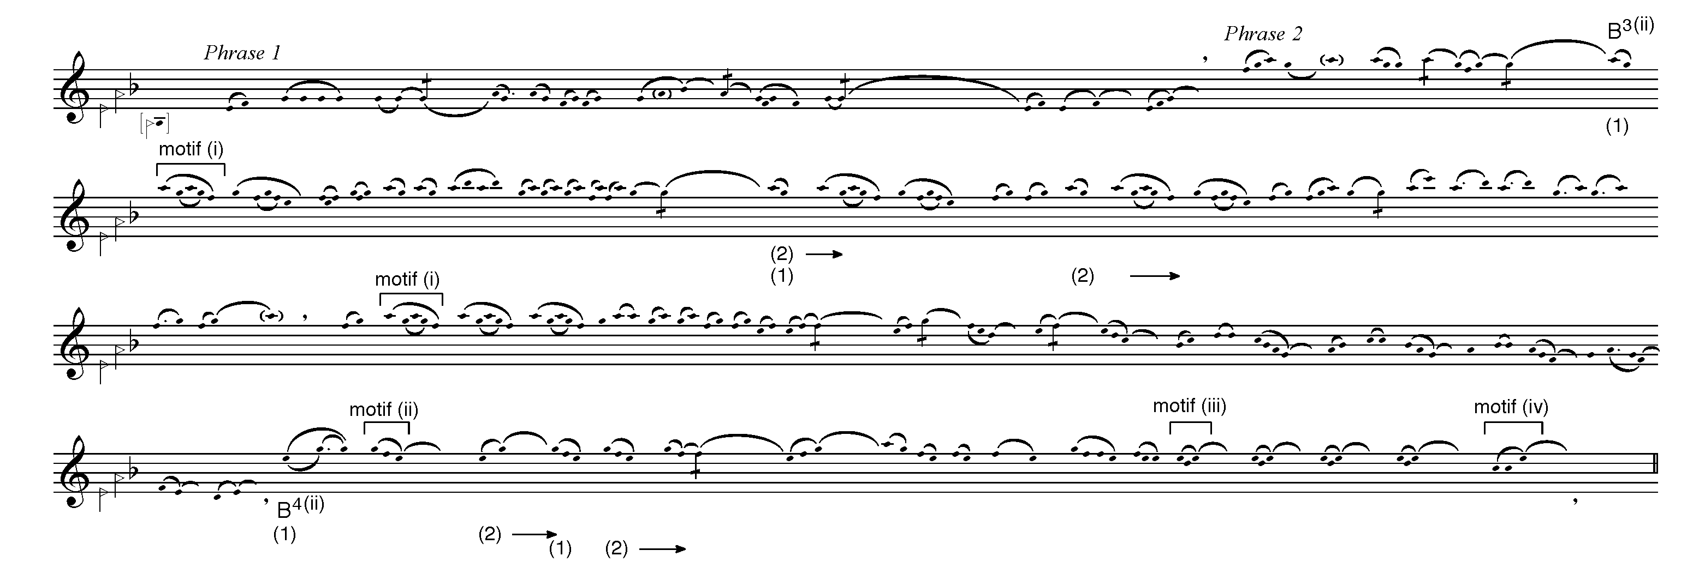
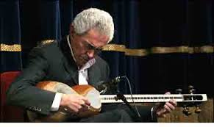

Gusheh zābol – performed by Farhang Sharif, tār (long-necked plucked lute). Unpublished recording, c.1970

Slide 5
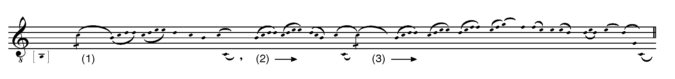
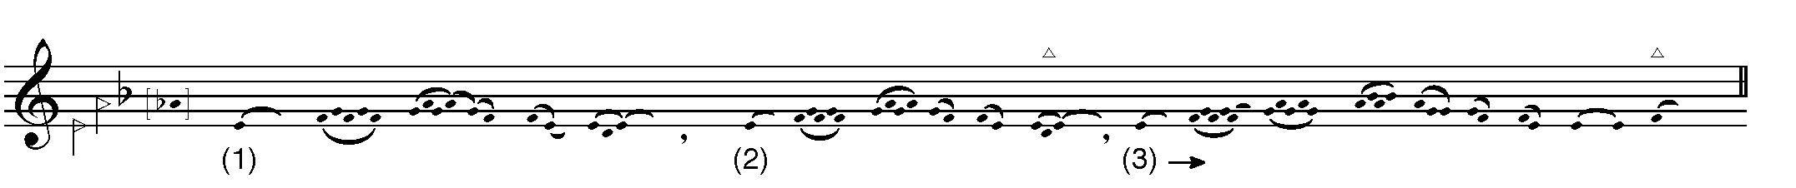
Strategies/principles
Different material developed in the same way
From Māhur, darāmad, Hossein Alizadeh (tār) (1986)
From Segāh, darāmad, Ahmad Ebadi (setār) (1970s)

Slide 6
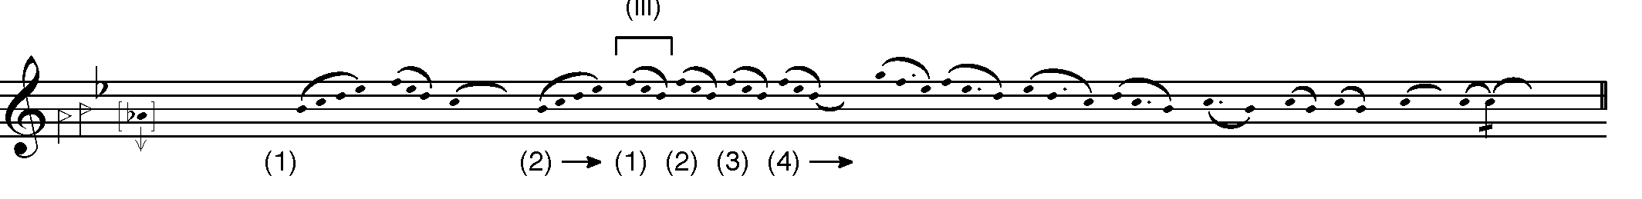
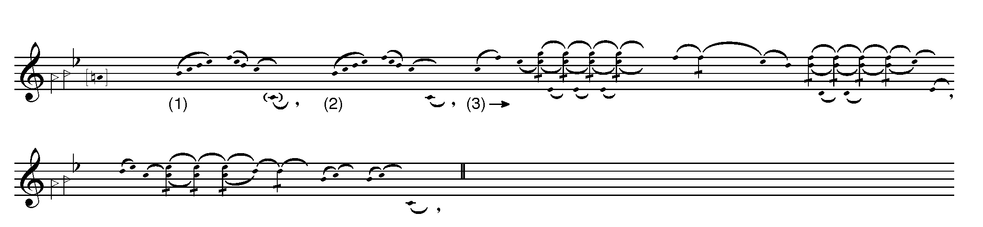
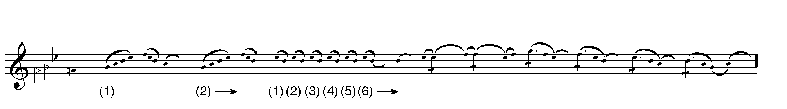
Strategies/principles
Opening of maqlub – same material developed differently
From Segāh, maqlub, Nur Ali Boroumand (tār) (1972)
From Segāh, maqlub, Hossein Tehrani (santur) (1976)
From Segāh, maqlub, Hooshang Zarif (tār) (1970s)

Slide 7
‘… repeated use of abstract musical strategies [which] produce entirely different musical phrases’ (Alaghband-Zadeh 2012)
(from ‘Formulas and the Building Blocks of ṭhumrī Style: A Study in “Improvised” Music’, Analytical Approaches to World Music Journal 2(1):1-48).
‘Ahal School musicians seem to absorb “compositional principles” in the process of learning a pre-composed repertoire … [and subsequently] apply these “principles” at appropriate moments in the inherited composition’. (Fossum 2010:180-1)
(from The Ahal School: Turkmen Dutar and the Individual. MA Thesis, Wesleyan University)

Slide 8
‘... a construction of the historian, taking shape and gaining coherence from the reciprocal (and rich and haphazard) interaction of his evolving assumptions with his increasingly meaningful data, the events he selects for inclusion in the context … . [according to this view] there is no culture of Bali except for the anthropologists’ construal – his thick description – of it, so there is no culture of sixteenth-century Mantua apart from our interpretation … As Collingwood put it, speaking only of history: ‘There is no past, except for a person involved in the historical mode of experience; and for him the past is what he carefully and critically thinks it to be.’ It is clear as well that the artifacts of culture exist for us only insofar as we perceive meaning in them in a cultural web. And this holds alike for Balinese shadow-plays, the puppets used in them, the poem that Monteverdi set to music, and Mozart’s G-minor Symphony’. (Tomlinson 1984:357)
(from ‘The Web of Culture. A Context for Musicology’, 19th-Century Music, 7(3): 350-62)

Slide 9
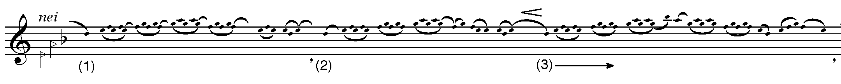
Example of extended repetition, gusheh zabol, Jamshid Andalibi (nei)

Slide 10
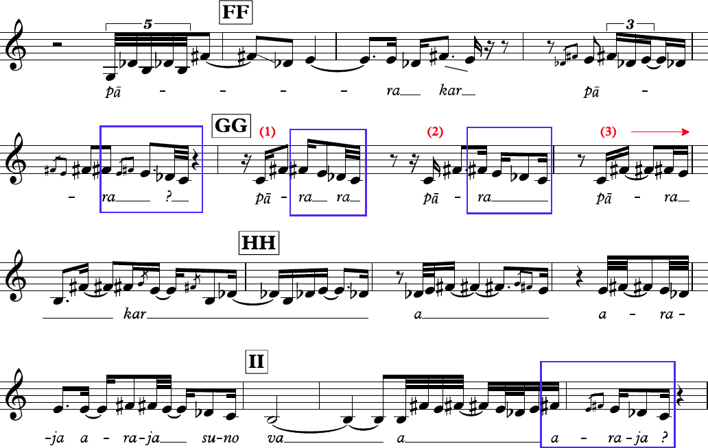
From a khyāl performance by Bhimsen Joshi in rāg pūriyā dhanāśrī and in jhaptāl (source: Pandit Bhimsen Joshi, Ragas Puriya Dhanashree and Lalita Gauri, Live at the I.C.A, London, Jul. 1985 (Navras NR0021 2 DDD, 1993)

Slide 11
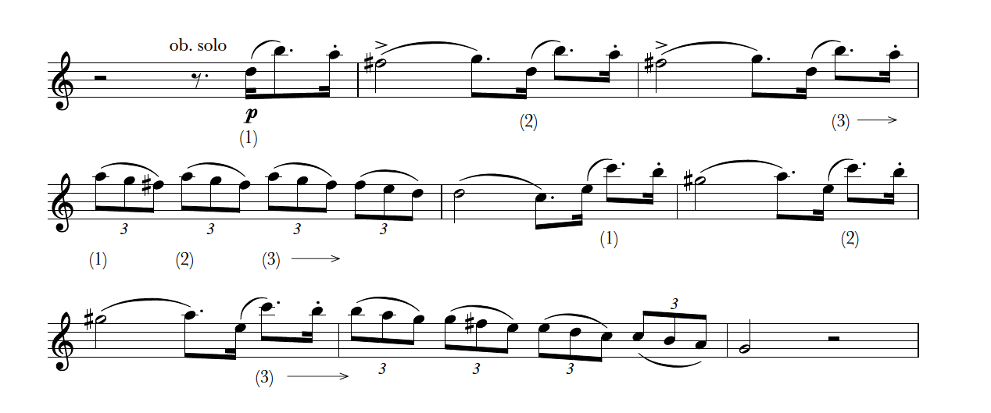
From the overture to The Italian Girl in Algiers (1813) by Gioachino Rossini

Slide 12
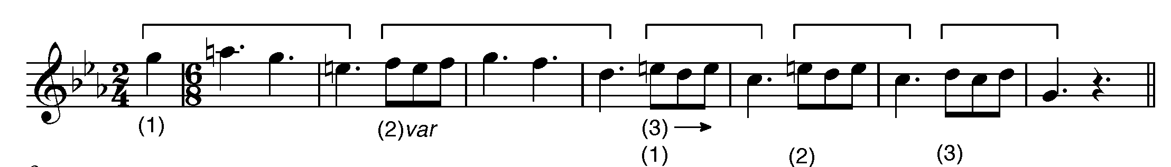
From the 3rd movement of the Piano Quintet in F, op.34 (1864) by Johannes Brahms

Slide 13
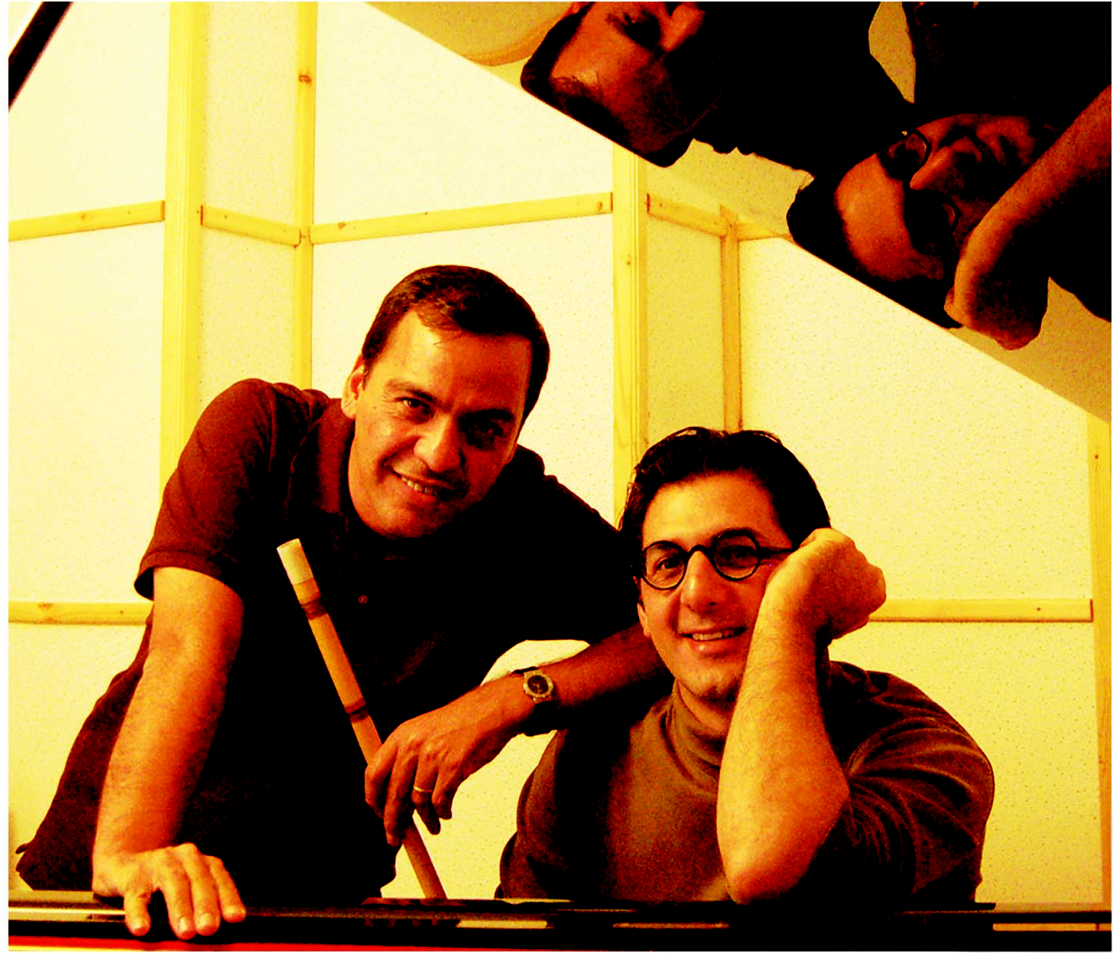
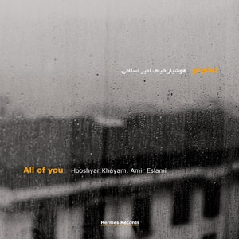
Amir Eslami (nei) and Hooshyar Khayam (piano)

Slide 14
Amir (in Persian): ‘It was very interesting. Hooshyar had released an album called A Thousand Acacias. On the first track, he just plays the strings of the piano with his bare hands. I really like this track. And one day, when I came home from the university – and this was really not a good time for me - I looked out this album. I put on the first track and suddenly felt like playing nei. The piece was in the mode of dashti and somehow resonated with how I was feeling at the time. I reached for my nei box, took an instrument at random and started improvising over the piano track. By some coincidence the nei that I had taken was tuned to the same mode. In this way, I recorded a line of nei over the piano track. The two lines worked well together and I decided to improvise again over the piano part, and to record it.’

Slide 15
Hooshyar (in English): ‘It was a bad day and we were experiencing harsh times. And then I received an mp3 file from Amir by email. And the subject of the email was ‘???’, I remember that very clearly. And when I opened it there was absolutely no explanation. I listened to the music with my wife, Mina, and we were both so affected by it that we started to cry. It was a fascinating experience, a very hurtful experience I have to say, because it just opened up something inside of us which had been there for a long time. So I took up the phone and called Amir. It was after midnight. And I said, ‘listen, we have to start working together, there’s no way round it’. And that is how our working together started. It was an instant decision. And it just stayed exactly like this because even at the times when we would sit together and speak about making a new piece, and even if our discussions were long, at the time we would go to the recording room, the process would be instant, very very fast’.
‘Zakhmeh’ (‘Strum’). Track 3
Hooshyar: ‘I felt that there was something I wanted to say [in the original piano piece] that I couldn’t, but that my friend was able to’.

Slide 16
‘shiveh-ye novin-e bedāheh-navāzi dar musiqi-ye Irani’ (‘a new approach to improvisation in Persian music’)
bedāheh-navāzi-e sonnati
‘negāh-e āhāngsāzāneh’ (‘a compositional view/approach’)
‘tafakor-e āhangsāzi’ (‘compositional thinking’)
HK: ‘We shape it structurally, we think about it. This is where it comes close to composition. They are compositions, we work them out. I think what we are doing has both qualities. We both have the experience of pure improvisation, but the common concept is that of structure’. (interview 26.11.10)

Slide 17
‘improvisation that is supported by compositional thinking’
HK: ‘All these tracks are improvisations, but some are worked out improvisations and some are just raw improvisation, entirely from scratch from beginning to end. We even played in a dark room so as to focus entirely on the music. But others are not like that. They have been worked out. They are ideas that we discussed what we wanted to do. Nevertheless, we think of these as improvisational because of the ‘in the moment’ [dar lahzeh] development of ideas. But we think of them as a different kind of improvisation from traditional improvisation’. (interview 16.7.11)
Music’)

Slide 18
HK: Now, ‘Khiāl’ is interesting. I went to my room one night and started playing on places of the piano which you normally wouldn’t. I played all the harmonics, pizzicato, hitting on the iron and on the back of the instrument, on the body – well, I wouldn’t say hitting because I was really caressing my instrument. And I was enjoying it. So, I gathered a large pile of sonic events and I put them into my computer. And then Amir came over. And he went to the room alone and played whatever he wanted. Of course, we had talked about the tonality, about what I was trying to get …
LN: So, it was two completely separate events?
HK: Yes. And then Amir went home and I started my personal improvisation on these. I took the sonic events and started to build the work. I put on the drone which I had had in mind. And then I started to insert these events, upon each other, and modify them. So, the composition started to take shape. And then I called Amir again and we started to work on it together, and he played some more. And this is what ‘Khiāl’ is. Now, when you listen to ‘Khiāl’ you absolutely wouldn’t guess how it’s put together. (interview 16.7.11)

Slide 19
gostaresh (‘expansion’)
degargoon-shodan (‘transformation’)
‘nucleus’ (‘hasteh’)
‘The whole process, then, is only completed when you can come to a final product and share it with some true “listeners”; which gives me a chance to hear it through their ears and see my creation through their minds’ eyes. Without this final stage, one would always feel unfinished with the work and such feeling can easily work against the creative process, making it happen less frequently. This need for having your work received by some audience is crucial to make your inner self believe that you have really given birth to what you’ve been cooking; something that I think is usually mistaken for the need of the artist to be praised. I personally find these two things very different’. (Negar Boubon, personal correspondence, August 2017)
Music’)

Slide 20

‘For instance, track 5 of my solo album – ‘Continu’ - the piece titled ‘Gharghab’ (in Persian) (‘deep waters’ in English). The whole piece was based on the very first phrase, the first 3 seconds of the piece, and built as I performed it in the studio. And that 1st phrase was a discovery that later was combined with my other findings about flowing rhythms and short minimalist-like connecting phrases’. (Negar Boubon, personal correspondence, August 2017)
Music’)

Slide 21
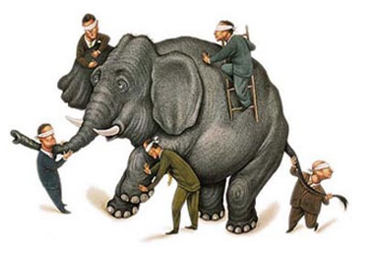
Music’)

