Slide 1

Impact of the subject metadata element on the discoverability of repository items on the Web
Lenka Shipton

Slide 2









Why Web?
To maximise the discoverability
Most users start search using search engine
City Research Online – 75% of all searches

Slide 3


Why subject?
Subjective
Can be affected by lack of knowledge
Constrained by controlled vocabularies
Difficult to apply to cross-disciplinary research
Difficult to apply consistently
Time consuming
Notes:
Lack of knowledge: this leads to a question who should be responsible for adding this information
At City: author uploads (self-deposit) but the repository admins classify individual deposits. This leads to a question, should we be looking at changing this? Difficulty for depositing via CRIS (Symplectic) – keywords but not subjects

Slide 4


How does it work?
Spiders and robots used by search engines to discover new pages on the Web
Metadata exposed in the form of <meta>tags
Not all <meta>tags are indexed

Slide 5
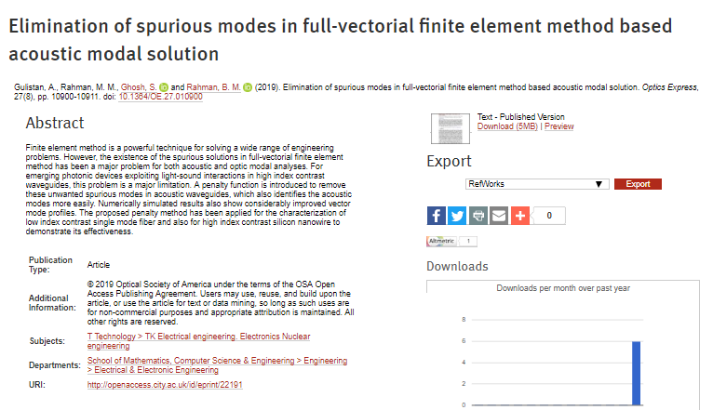
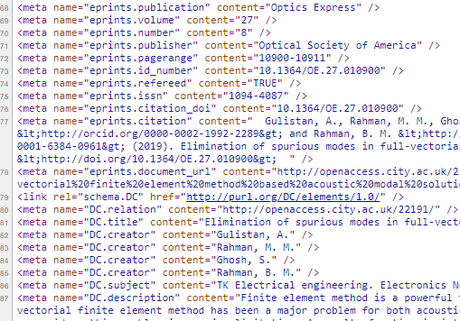
Metadata to <meta>tags
Repository item record
Page source of the item record

Slide 6






How was it done?
2 random samples
Google analytics keyword search
Keywords matched to content of metadata fields
Searches reproduced and rankings recorded
Notes:
People only look at first two pages of results

Slide 7
The results – metadata elements

Slide 8
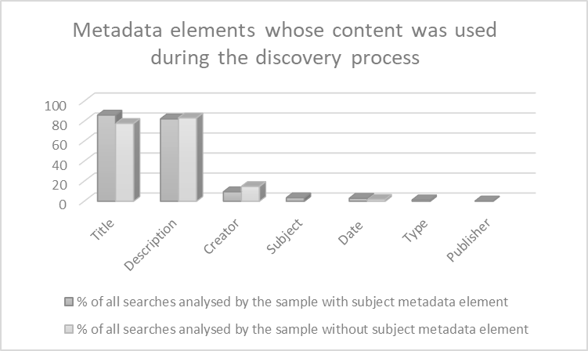

Slide 9
The results – rankings

Slide 10
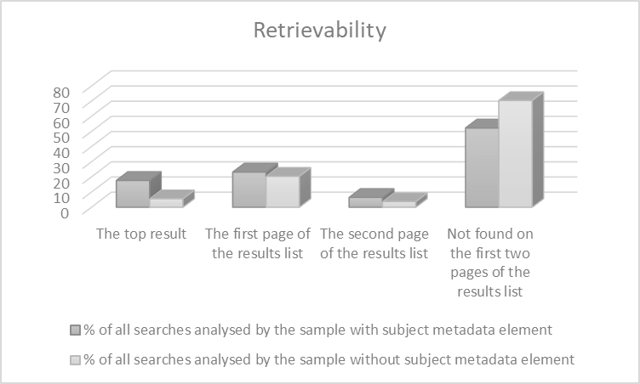

Slide 11



Caveats
Ever changing content indexed by search engines
Change in ranking positions
Changing algorithms
Search engine personalisation
Two samples
  Different size
  Different collection period
Notes:
Searches and results are irreproducible
Algorithms – focus on good resource description at all times

Slide 12
City, University of London
Northampton Square
London
EC1V 0HB
United Kingdom
T: +44 (0)20 7040 5060
E: department@city.ac.uk
www.city.ac.uk/department
Thank you!
Lenka.Shipton.1@city.ac.uk

