Slide 1

Meat food waste in households
Using discrete event simulation to provide an evidence base for reducing global household meat waste
67th International Congress of Meat Science and Technology, August 27, 2021, Kraków, Poland.
Dr Christian Reynolds
Centre for Food Policy, City, University of London
@sartorialfoodie
christian.reynolds@city.ac.uk

Slide 2
Talk outline
Global food loss and waste – why is it important?
    Definitions of food loss and waste
Why is meat loss and waste important?
Insights from a 9 country pilot survey
Introducing - household simulation model
    Chicken breast case study
Solutions for meat waste in households

Slide 3










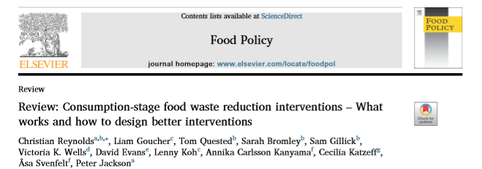
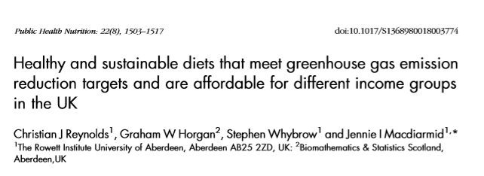
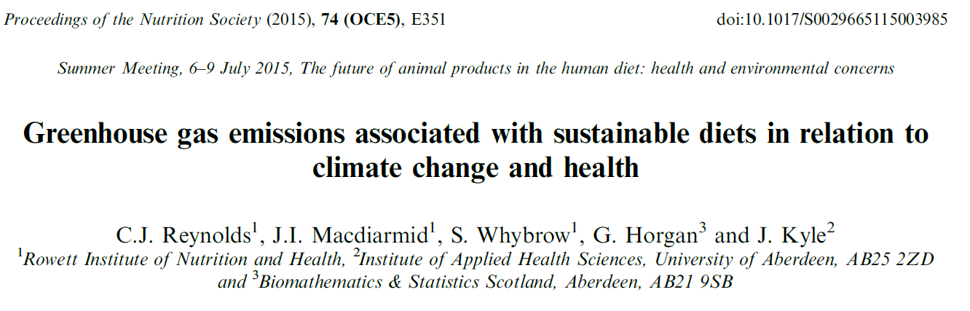
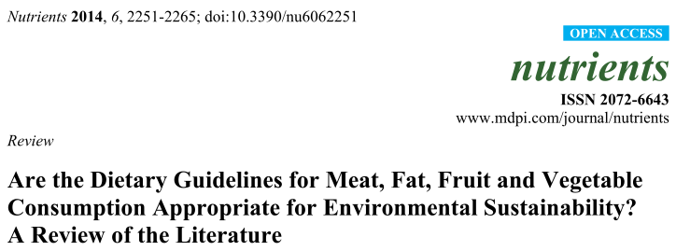
Who am I? – Christian Reynolds
Senior Lecturer at the Centre for Food Policy
Focus: healthy sustainable diets and food consumption (including waste)
Previously: Food waste politics/history, social sciences approaches

Slide 4
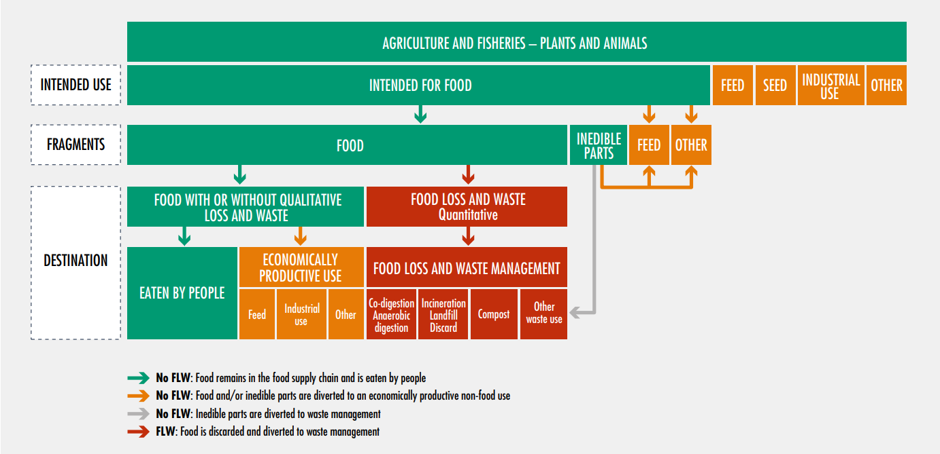
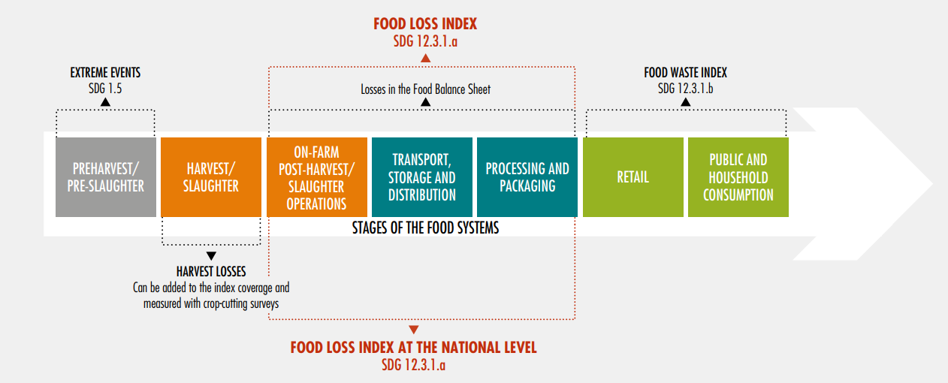
Definitions – Food Loss and Food Waste
NOTE –the change of
Edible and in-edible (current definition)
vs
Avoidable, Possibly avoidable, Unavoidable (previous definition)
https://flwprotocol.org/
http://www.fao.org/3/ca6030en/ca6030en.pdf

Slide 5
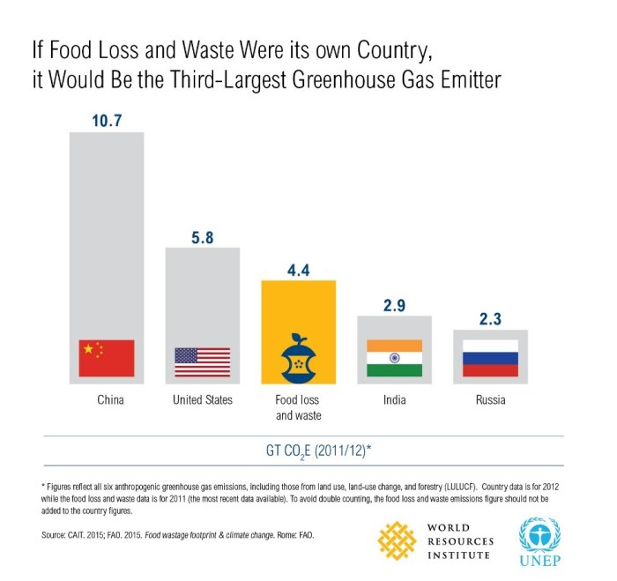
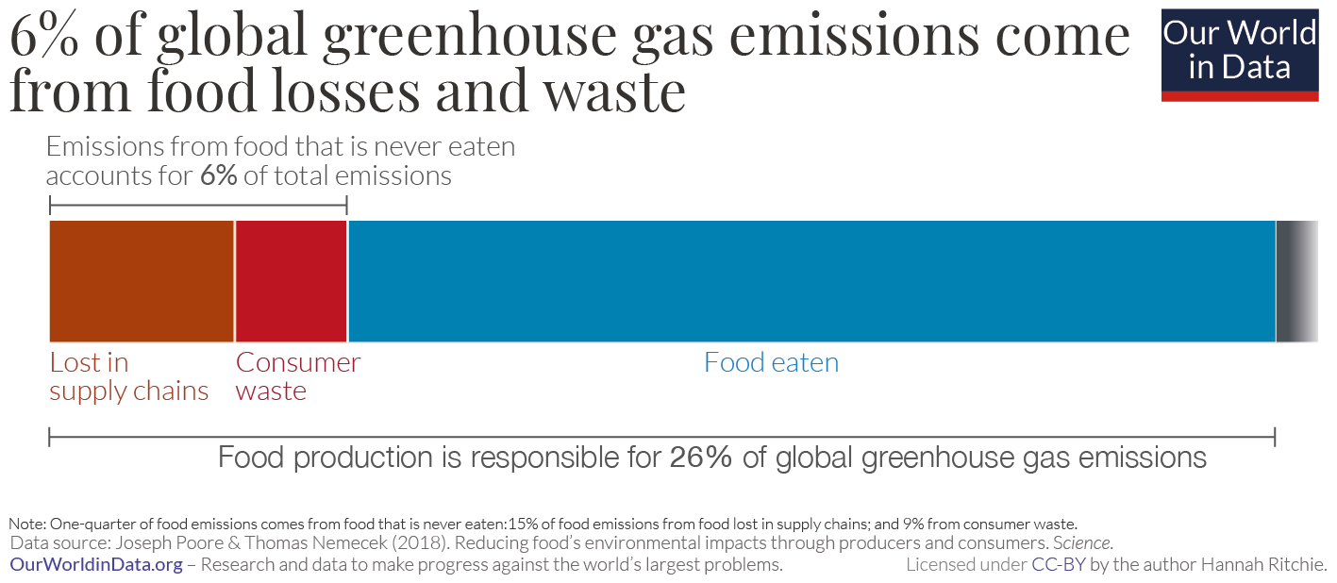
Food loss and waste is a climate issue

Slide 6
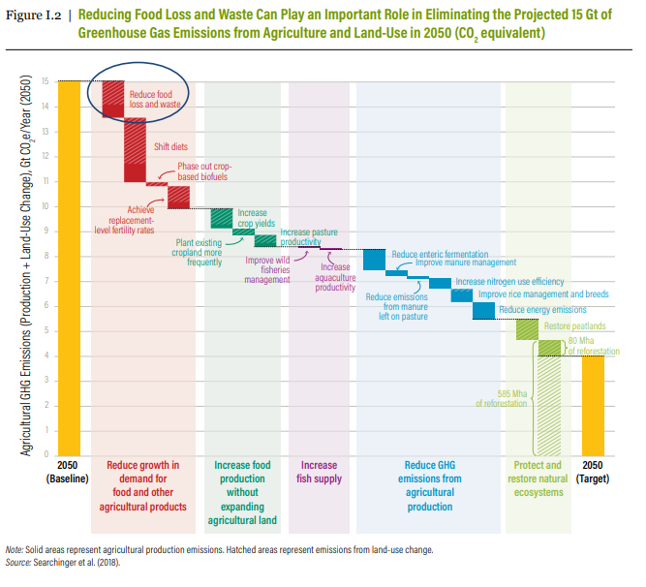
FLW reduction is one of the biggest actions we can take to reduce global GHGE
Source: WRI, REDUCING FOOD LOSS AND WASTE Setting a Global Action Agenda https://wriorg.s3.amazonaws.com/s3fs-public/reducing-food-loss-waste-global-action-agenda_1.pdf

Slide 7
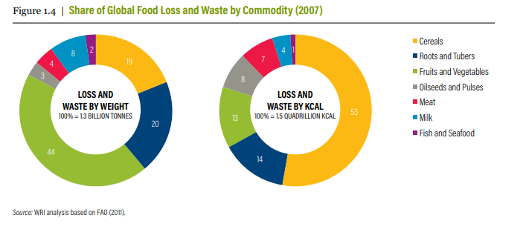
FLW is more than carbon! -
1.3 billion tonnes or 1.5 Qt Kcal wasted!
Source: WRI, REDUCING FOOD LOSS AND WASTE Setting a Global Action Agenda https://wriorg.s3.amazonaws.com/s3fs-public/reducing-food-loss-waste-global-action-agenda_1.pdf

Slide 8
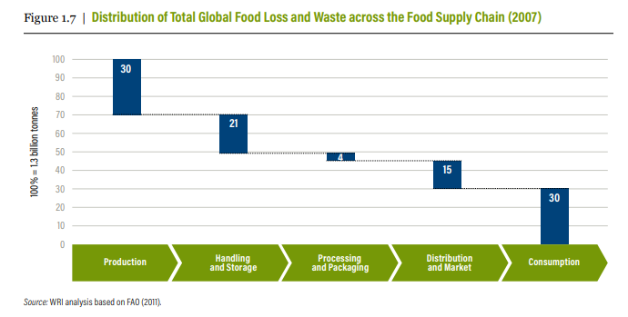
FLW Spread across the supply chain
Source: WRI, REDUCING FOOD LOSS AND WASTE Setting a Global Action Agenda https://wriorg.s3.amazonaws.com/s3fs-public/reducing-food-loss-waste-global-action-agenda_1.pdf

Slide 9
Selection of reasons / drivers for FLW
Primary Production | Processing and Manufacturing | Distribution and Wholesale | Retail | Food Service/ Institutions | Household
Spillage Cosmetic or physical damage Damage from pests or animals Not harvested Unable to sell due to quantity or size Unable to reach market | Spillage Trimming during processing Rejected from market | Cosmetic or physical damage Spoilage Past sell-by date Rejected from market Unable to reach market | Product recall Food prepared improperly Food cooked but not eaten Cosmetic damage Spoilage Past sell-by date | Product recall Food prepared improperly Food cooked but not eaten Cosmetic damage Spoilage | Product recall Food prepared improperly Food cooked but not eaten Cosmetic Damage Spoilage Past sell-by or use-by date
Source: Food Loss and Waste Accounting and Reporting Standard, 2016

Slide 10
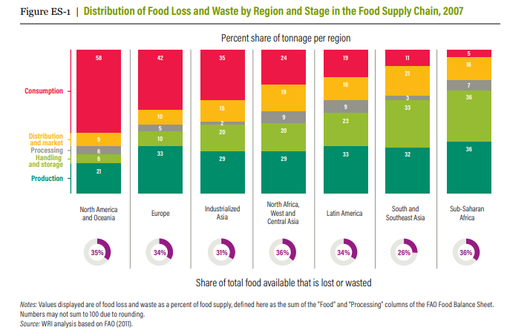
FLW Spread across the globe
Source: WRI, REDUCING FOOD LOSS AND WASTE Setting a Global Action Agenda https://wriorg.s3.amazonaws.com/s3fs-public/reducing-food-loss-waste-global-action-agenda_1.pdf

Slide 11
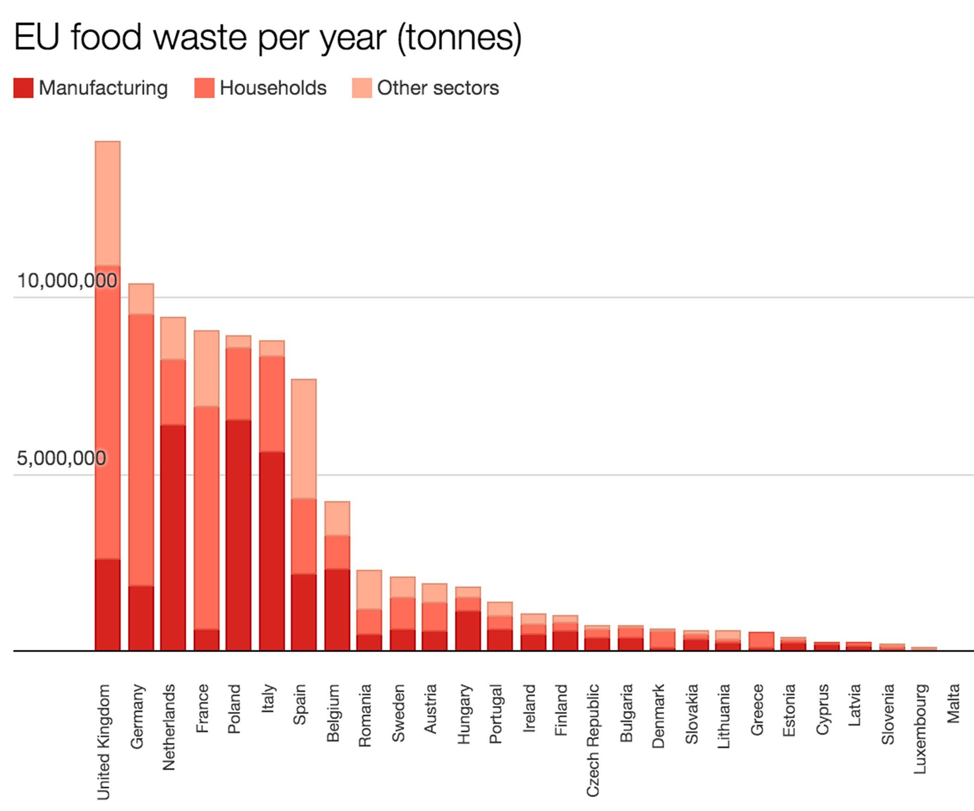
European tonnages (FUSIONS estimates)
What about Inter-country FLW?
(Rotterdam?)
A side-note about “On Farm” loss and waste…
EU Implementing and Delegated acts 2019-2021

Slide 12
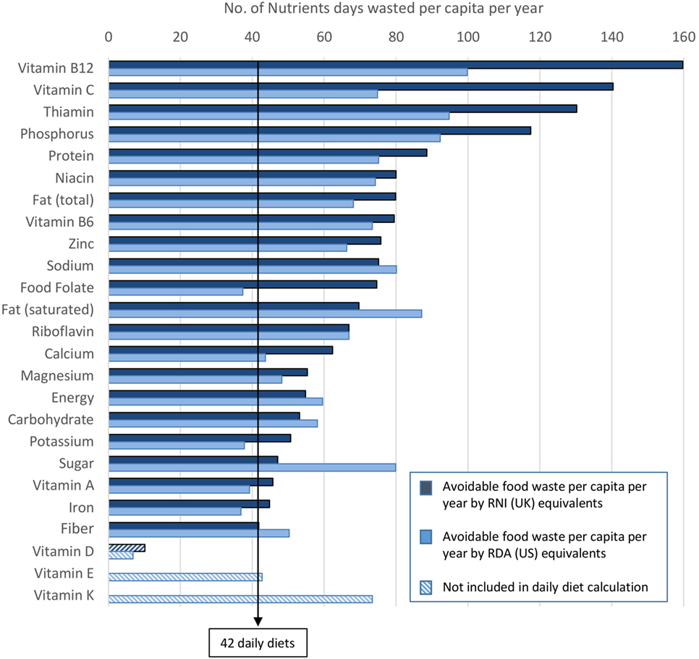
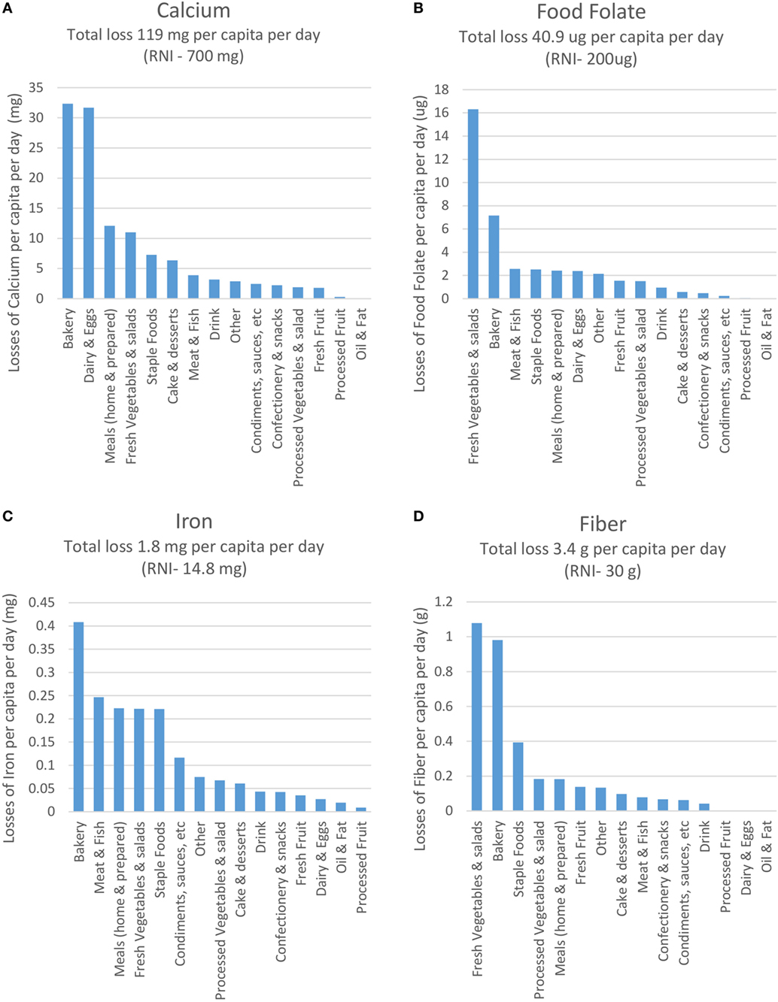
The UK numbers – a (nutrition) perspective
The amounts of individual nutrients wasted per capita per year in UK (Household food waste only), and per food grouping per capita per day (Cal, Folate, Iron, Fiber). Edible waste
https://www.frontiersin.org/articles/10.3389/fnut.2018.00019/full

Slide 13
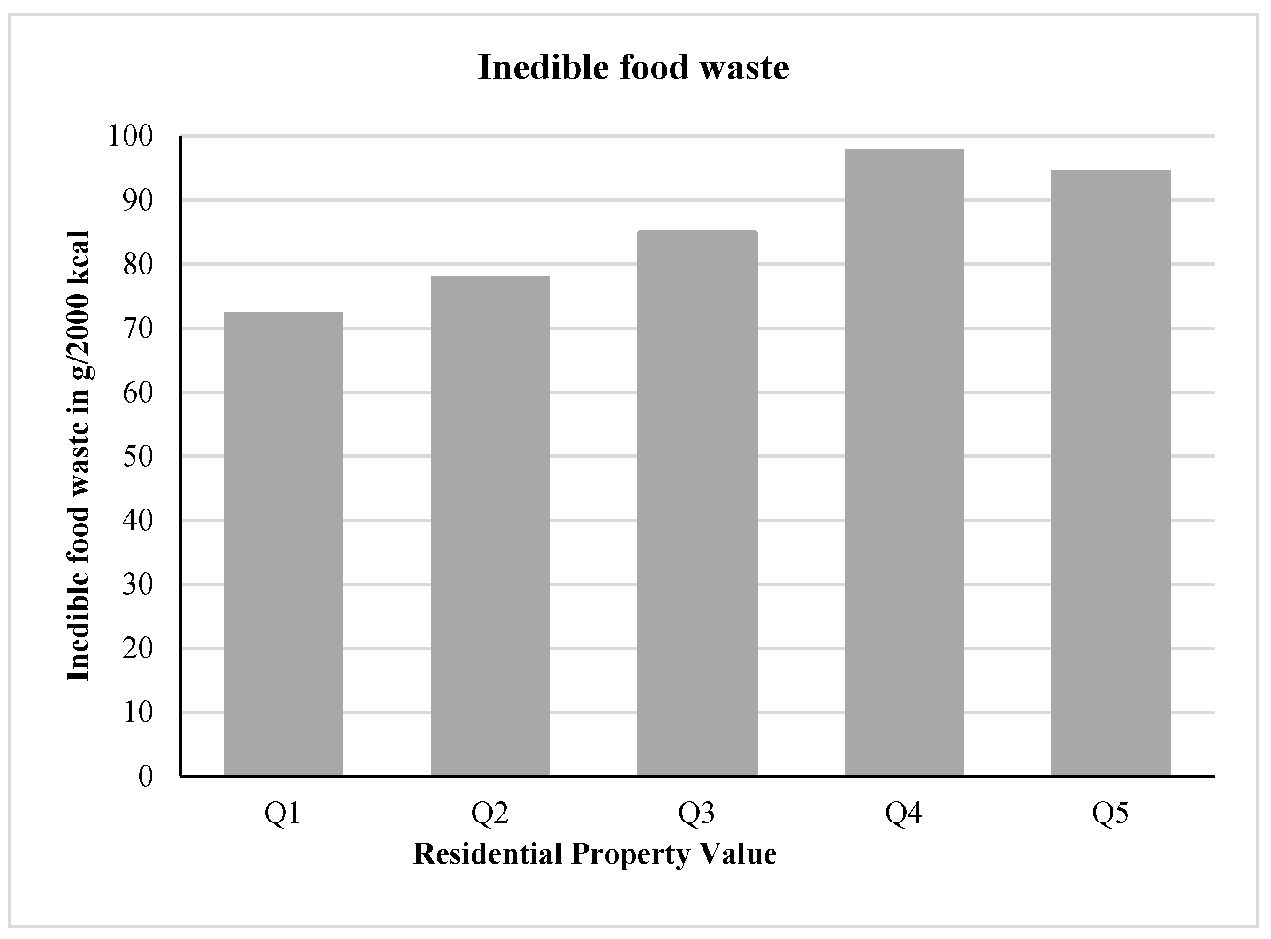
Inedible food waste – a reminder
Even if we stop all edible food waste we will have inedible food waste, and this is linked to dietary choices!
This includes “inedible” bones, skin, fat etc.
Inedible food waste (g/2000 kcal) and quintiles of residential property value https://www.mdpi.com/2072-6643/13/2/479/htm https://doi.org/10.3390/nu13020479

Slide 14
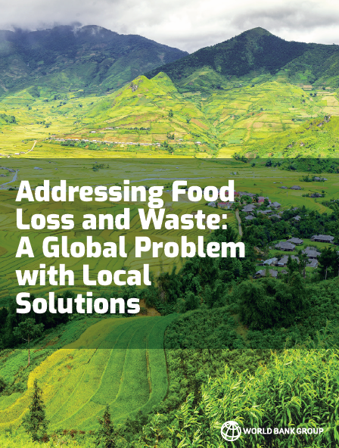
Action needed at different points in the supply chain, for diff. products/countries…

Slide 15
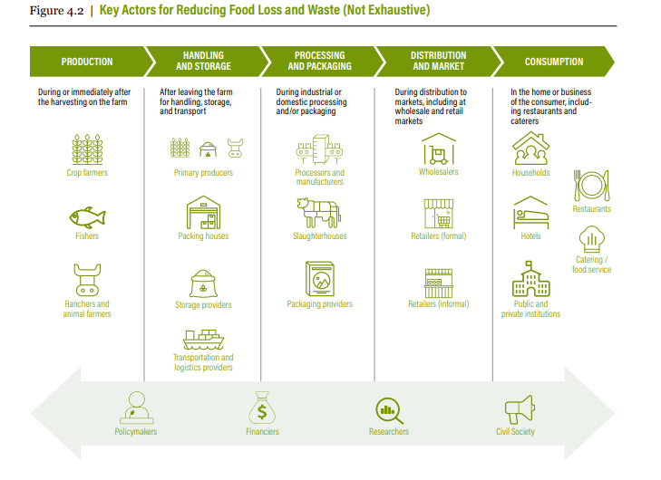
Action from many actors needed
Source: WRI, REDUCING FOOD LOSS AND WASTE Setting a Global Action Agenda https://wriorg.s3.amazonaws.com/s3fs-public/reducing-food-loss-waste-global-action-agenda_1.pdf

Slide 16
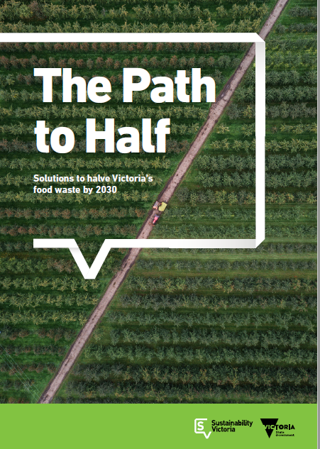
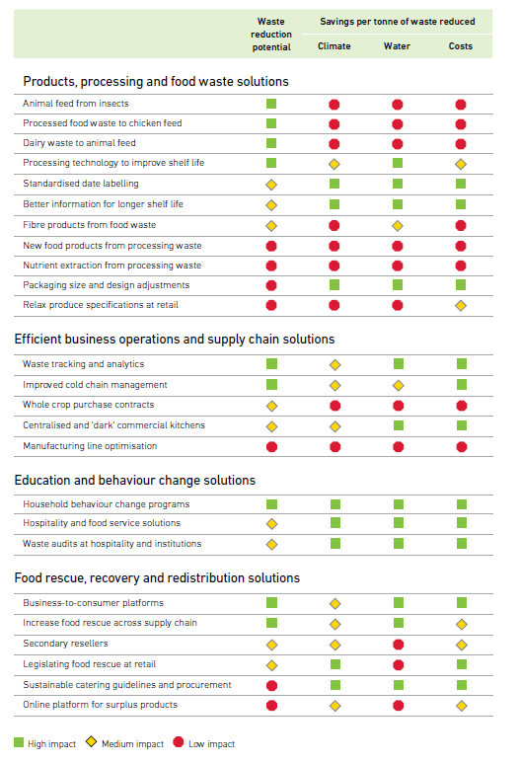
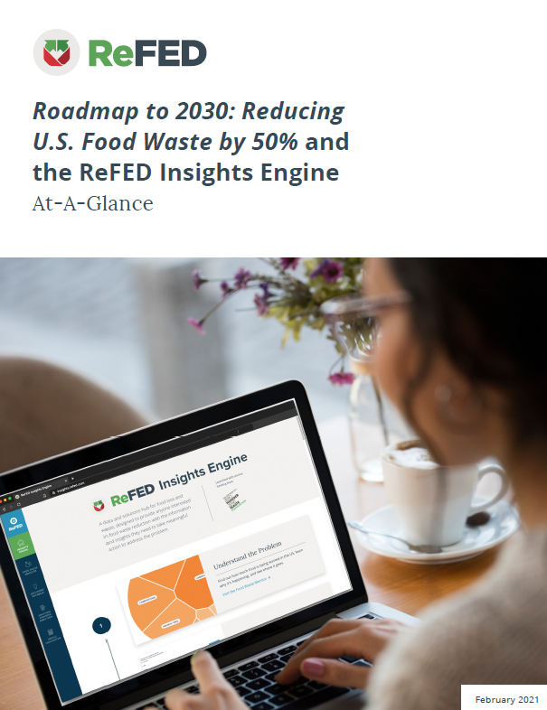
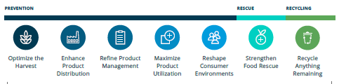
Many (food systems) solutions to FLW
The Path to Half 25 solutions
ReFED 73 solutions
Many solutions are linked to meat production

Slide 17
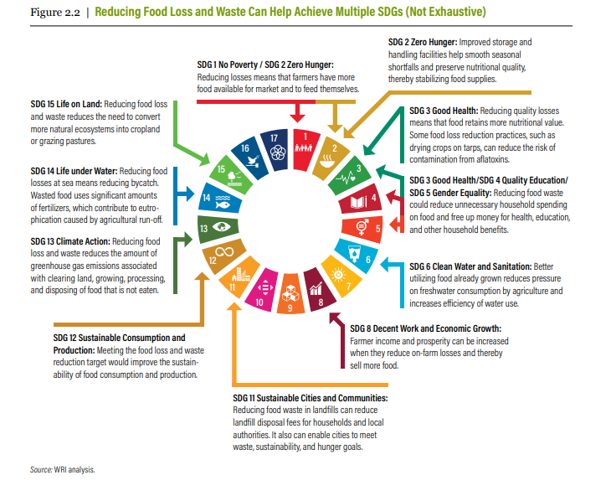
FLW solutions can help multiple other areas
Source: WRI, REDUCING FOOD LOSS AND WASTE Setting a Global Action Agenda https://wriorg.s3.amazonaws.com/s3fs-public/reducing-food-loss-waste-global-action-agenda_1.pdf

Slide 18
Not all solutions are created equal
A 50% reduction in waste… at different stages
Reducing food waste “down” stream (household) has less cascading ripple effects

Slide 19
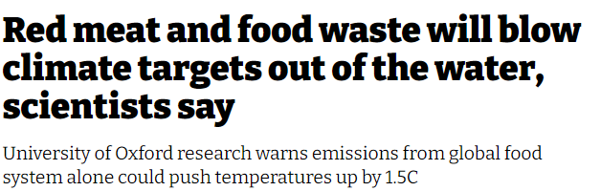
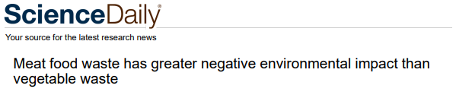
But why is Meat food waste important?
Meat food waste has a big carbon footprint, and a big economic cost Reduction of meat food waste is a double win.
19% of UK food waste’s monetary value is meat waste.
https://wrap.org.uk/sites/files/wrap/Progress_against_Courtauld_2025_targets_and_UN_SDG_123.pdf
https://www.wrap.org.uk/sites/files/wrap/Household%20food%20waste%20restated%20data%202007-2015%20FINAL.pdf

Slide 20
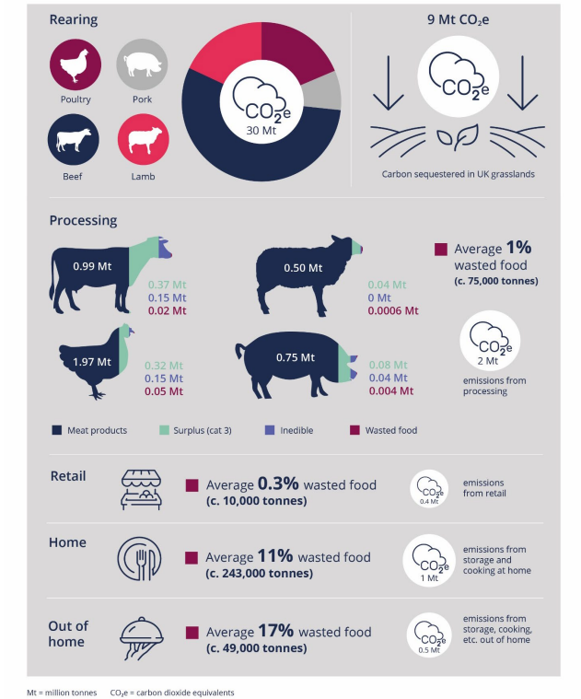
Food waste and greenhouse gas emissions in the UK meat supply chain
Supply chain stage | Meat waste based Mt CO2e | % contribution to Supply chain stage | % contribution to total value chain emissions
Rearing | 30 | 66% | 21%
Processing | 2 | 24% | 1%
Retail | 0.4 | 8% | 0%
Home | 1 | 8% | 1%
Out of Home | 0.5 | 7% | 0%
 | 33.9 |  | 23%
23% of UK food waste’s carbon impact is meat waste.
https://wrap.org.uk/sites/default/files/2020-07/WRAP-Meat-in-a-Net-Zero-world-publication.pdf
https://wrap.org.uk/sites/default/files/2020-09/UK-progress-against-Courtauld-2025-targets-and-UN-SDG-123.pdf

Slide 21
The GHGE Impact of (UK) meat production and waste is bigger than many other foods

Slide 22
But waste does not happen in the food system where the GHGE are generated.
We need to solve household food waste AS WELL as decarbonise food production

Slide 23
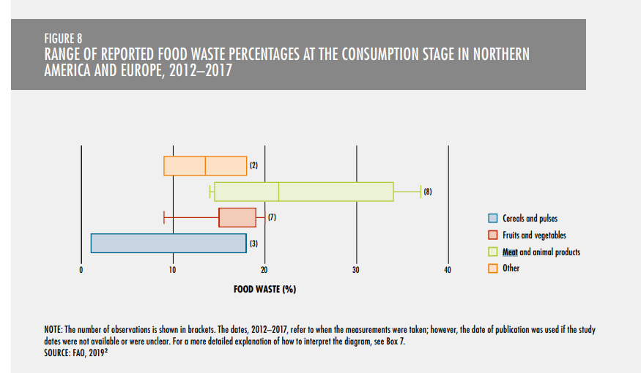
Wide range of meat waste % globally
- But a lack of solid data in every country (2019)
http://www.fao.org/3/ca6030en/ca6030en.pdf

Slide 24
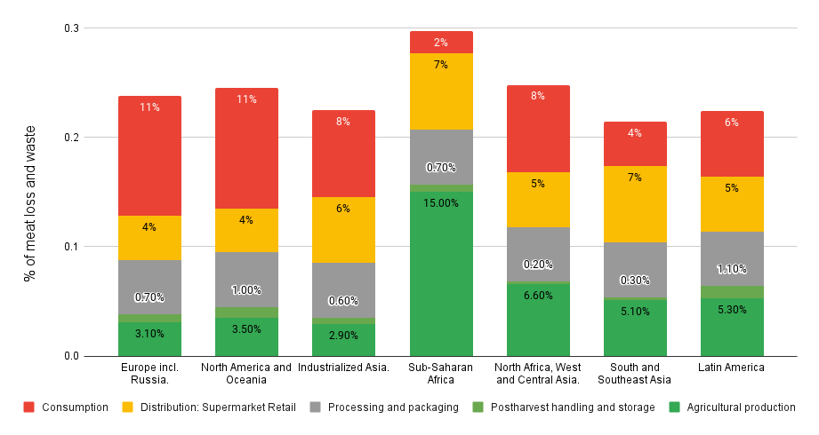
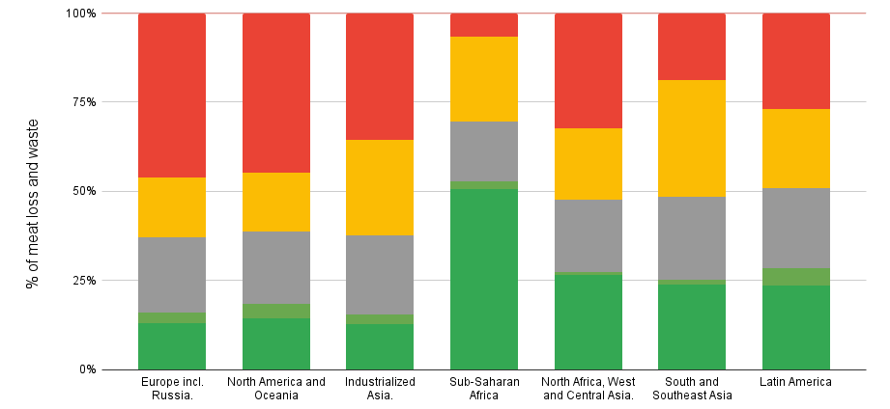
% of global meat loss and waste per region (2011)
Source FAO (Gustavsson et al. 2011)

Slide 25
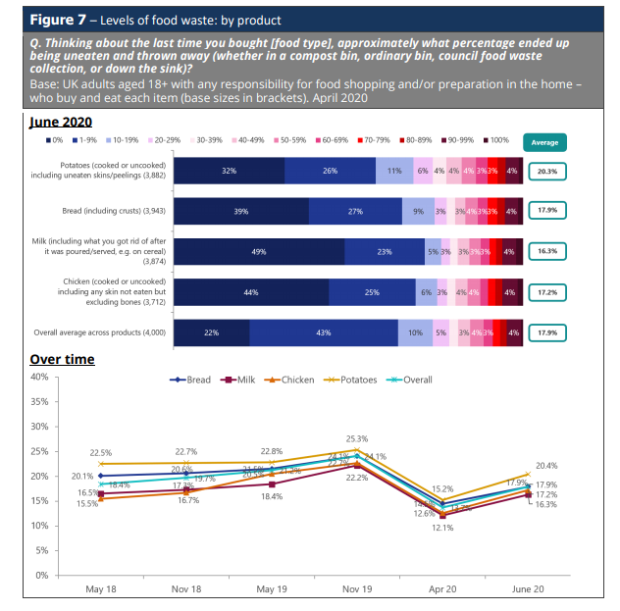
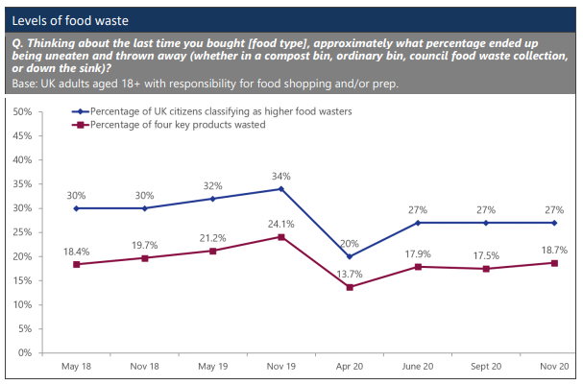
UK specific self reported food waste and COVID19
Online survey Apr, June, Sept, Nov 2020 with a nationally representative sample of 4,000 UK adults aged 18+
https://wrap.org.uk/sites/default/files/2021-02/WRAP-Life-under-Covid-19-Food-waste-attitudes-and-behaviours-in-2020.pdf

Slide 26
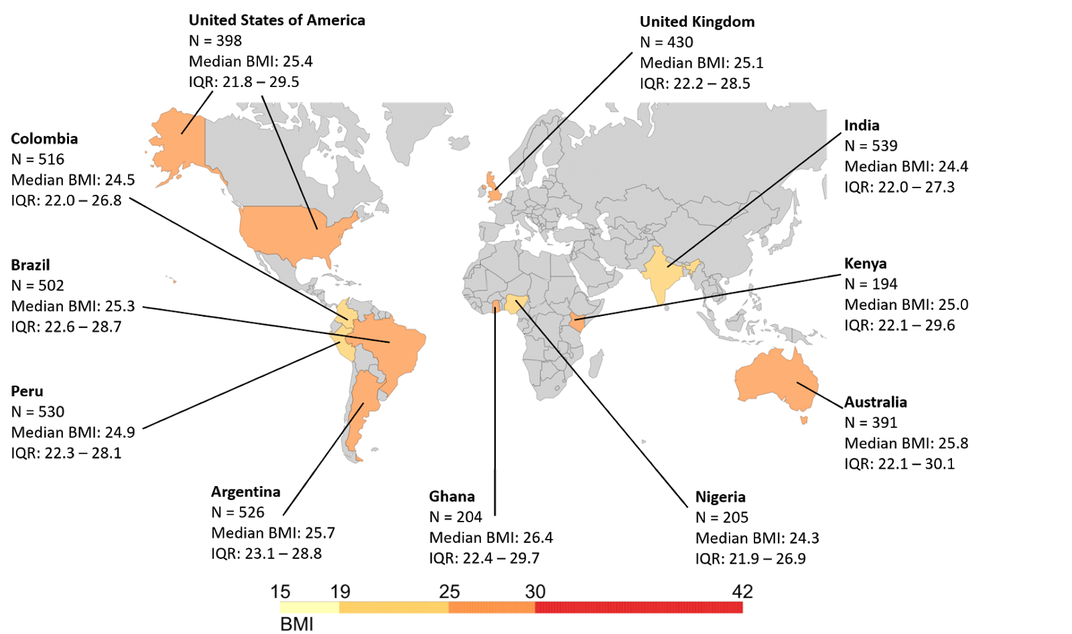
“Phase 3” pilot – (Just as COVID19 started…)
“Phase 3” 25th March to 7th April 2020,
How consumer perceptions, shopping and cooking habits, food waste, and food security status changed between 10 countries (10 foods+). Data collection from 10 countries of consumers was conducted using an online survey (Qualtrics panels)

Slide 27
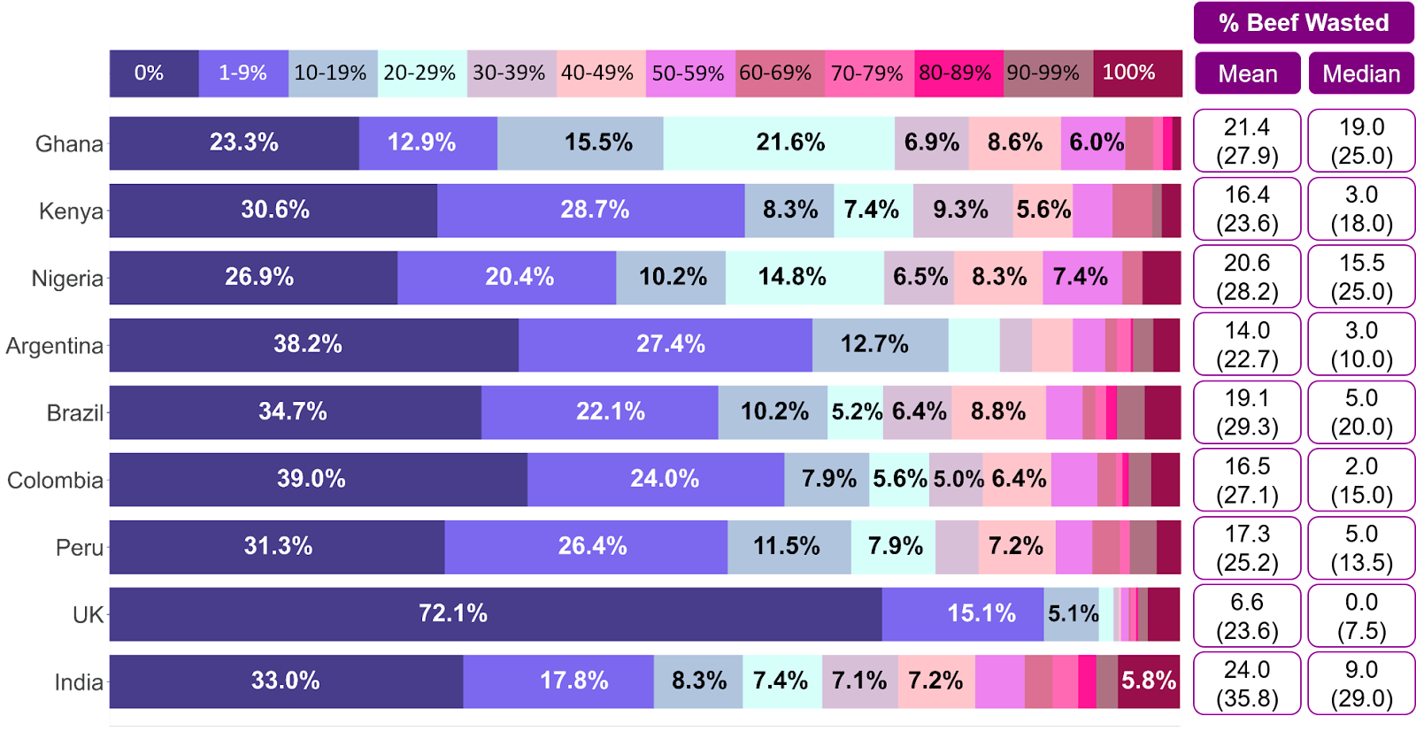
Country specific self reported food waste
“Phase 3” Pilot survey - Beef
“Thinking about the last time you bought the following food (Beef), approximately what percentage of the amount you bought ended up being uneaten and thrown away (please include all food that was not eaten - e.g. put in a bin, compost bin, down the sink, given to animals etc) -
Number in brackets is the mean or median excluding those who do not waste anything.
As there is a proportion who think/recall that they do not waste anything (even though they might)

Slide 28
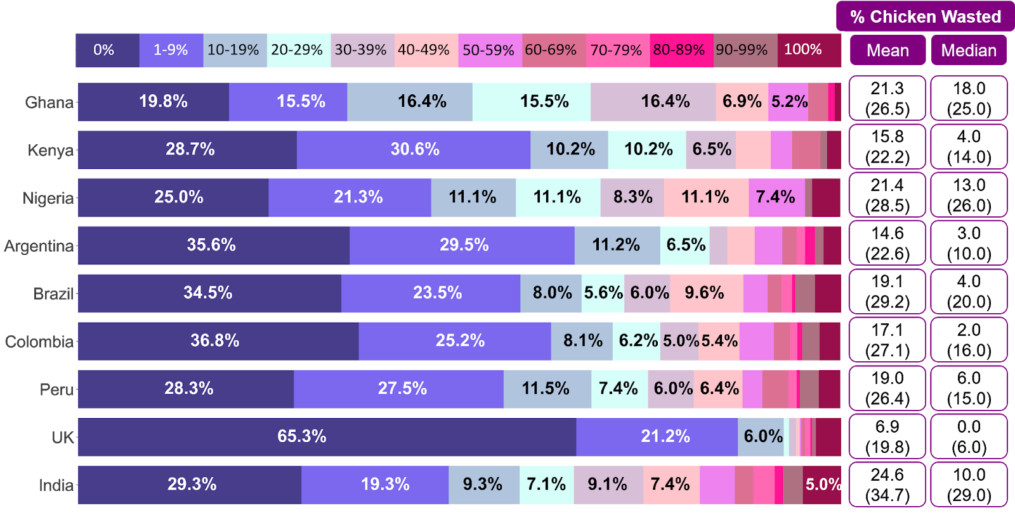
Country specific self reported food waste
“Phase 3” Pilot survey - Chicken
”Thinking about the last time you bought the following food (Chicken), approximately what percentage of the amount you bought ended up being uneaten and thrown away (please include all food that was not eaten - e.g. put in a bin, compost bin, down the sink, given to animals etc) -
Number in brackets is the mean or median excluding those who self reported not wasting anything.
As there is a proportion who think/recall that they do not waste anything (even though they might)

Slide 29
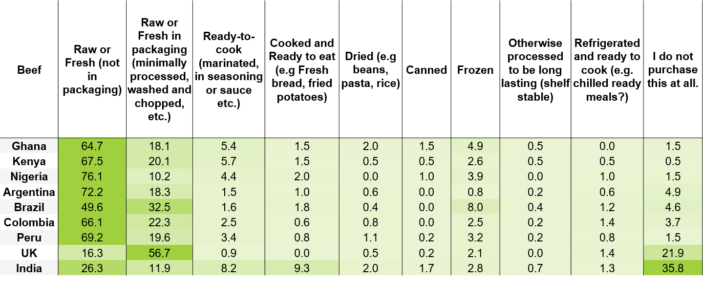
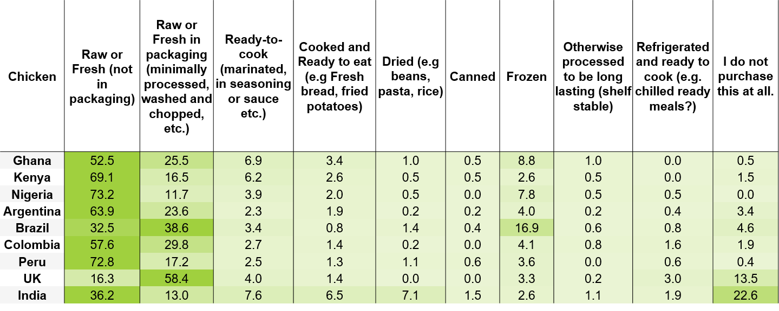
Variability between countries on how meat is purchased/packaged
“What is the most common way you usually purchase the food items listed below?”
You can see that different markets shop for meat differently…
… This has impacts on waste levels
The effects of food packaging on perceived (self-reported) bought food waste
 | Beef |  | Chicken
Source | F | Sig. | F | Sig.
Effects | 9.683 | 0.000 | 10.952 | 0.000
No. Participants | 3430 |  | 3430
Mean (%) of perceived bought food waste by package type
Source | Beef | Chicken
Raw or Fresh no packaging | 16.705 | 17.068
Raw or Fresh in packaging | 15.067 | 15.714
Ready-to-cook | 27.470 | 25.485
Cooked and Ready to eat | 34.062 | 27.807
Dried | 35.182 | 41.322
Canned | 30.125 | 39.125
Frozen | 15.363 | 15.831
Otherwise processed to be long lasting | 31.444 | 30.882
Refrigerated and ready to cook | 17.571 | 14.450
I do not purchase this at all | 13.976 | 14.762

Slide 30
Effects of shop/place and frequency on meat waste
Online shopping, and not shopping at supermarkets, and eating meat with every meal were significant drivers of higher self-reported food waste – these are all complex interactions, (and pilot data)
The effects of where participants shop for food on perceived (self-reported) bought food waste
 | Beef |  | Chicken
Source | F | Sig. | F | Sig.
Large supermarket | 26.582 | 0.000 | 21.546 | 0.000
Smaller supermarket | 13.434 | 0.000 | 14.944 | 0.000
Local/corner shop | 0.779 | 0.377 | 1.309 | 0.253
Roadside stall | 1.586 | 0.208 | 2.456 | 0.117
Independent seller | 1.008 | 0.316 | 2.822 | 0.093
Market | 0.034 | 0.854 | 0.006 | 0.940
Farm | 5.717 | 0.017 | 4.166 | 0.041
Home delivery | 0.313 | 0.576 | 0.909 | 0.340
Other shops | 0.519 | 0.472 | 4.772 | 0.029
Online shopping | 7.582 | 0.006 | 8.277 | 0.004
Organic shops | 0.223 | 0.637 | 0.375 | 0.540
grow my own food | 2.688 | 0.101 | 5.247 | 0.022
Given by family or friends | 2.309 | 0.129 | 2.614 | 0.106
No. Participants | 3430 |  | 3430
The effects of eating frequency on perceived (self-reported) bought food waste
 | Beef |  | Chicken
Source | F | Sig. | F | Sig.
Effects | 5.188 | 0.000 | 9.519 | 0.000
No. Participants | 3430 |  | 3430
Mean (%) of perceived bought food waste by how often food is eaten
Source | Beef | Chicken
Less than once a month | 15.213 | 15.013
Once a Month | 15.282 | 18.792
Once a Week | 16.590 | 16.764
Several times a week | 17.346 | 16.390
Once a day or most days | 18.838 | 21.308
Every meal | 26.514 | 30.534
No. Participants
Source | Beef | Chicken
Less than once a month | 653 | 380
Once a Month | 379 | 240
Once a Week | 962 | 787
Several times a week | 998 | 1490
Once a day or most days | 290 | 402
Every meal | 148 | 131
Mean (%) of perceived bought food waste
 | Beef |  | Chicken |  | No. Participants
Source | No | Yes | No | Yes | No | Yes
Large supermarket | 20.530 | 15.780 | 20.720 | 16.500 | 1020 | 2695
Smaller supermarket | 19.080 | 15.760 | 19.840 | 16.240 | 1453 | 2262
Online shopping | 16.430 | 19.050 | 16.940 | 19.910 | 2907 | 808

Slide 31
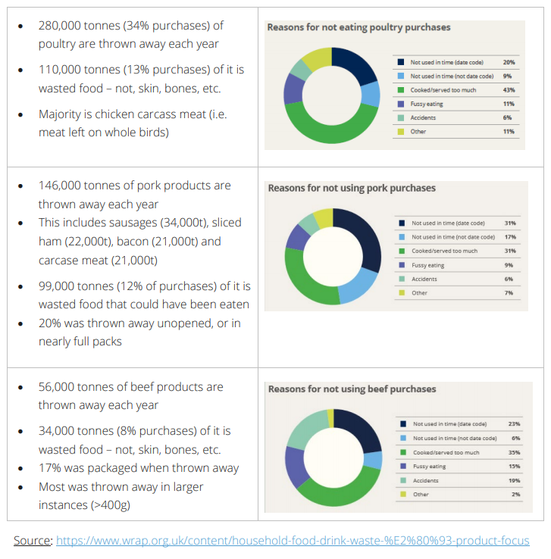
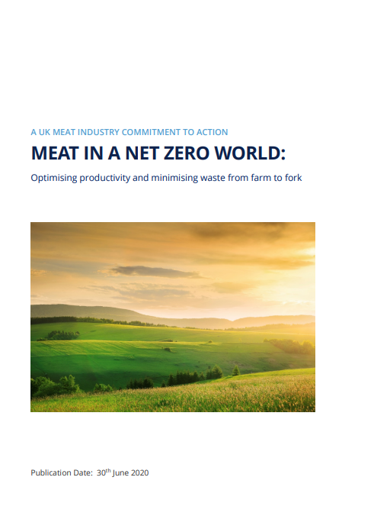
Scale and reasons for meat waste at home (UK)
Drawing on a wider UK evidence base we find:
Different reasons for waste for different types of meat due to their consumption/ shopping patterns, packaging etc. - these are all complex interactions.
https://wrap.org.uk/sites/default/files/2020-07/WRAP-Meat-in-a-Net-Zero-world-publication.pdf

Slide 32
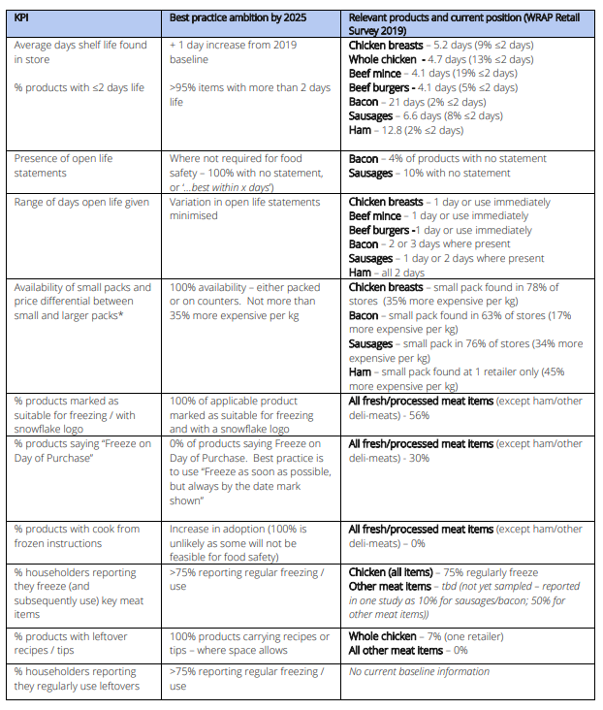
Actions to reduce meat waste at home (UK)
Different actions for different types of meat due to their consumption/shopping patterns, packaging etc. –
But how did we come up with these?
What impact could these actions have?
https://wrap.org.uk/sites/default/files/2020-07/WRAP-Meat-in-a-Net-Zero-world-publication.pdf

Slide 33
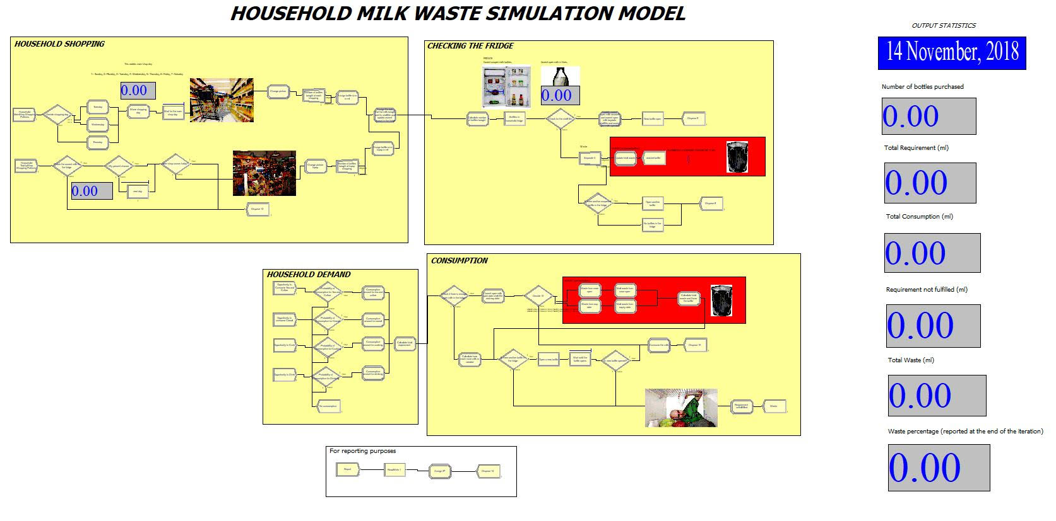
The household simulation model
The Household Simulation Model (HHSM) uses an approach called Discrete Event Simulation (DES) – which models a system as a sequence of events over time.
The ‘system’ in this case is a household, focusing on the journey of a type of food through the household from purchasing to either consumption or being thrown away.
The HHSM a long period of time (years or decades) to simulate multiple decisions made by a householder related to when they go shopping, how much they buy, where they store the product, when and how much to use and under what circumstances it gets thrown away.
A key element of DES is its probabilistic nature. For instance, the shelf-life is not always the same; it varies over a distribution of likely values. Similarly, the decisions made by householders will not always be the same, e.g. the amount of food used each day will vary.
Therefore, in the simulation, the amount of food eaten each day is determined by taking values at random from a distribution of likely values determined from consumption data.

Slide 34
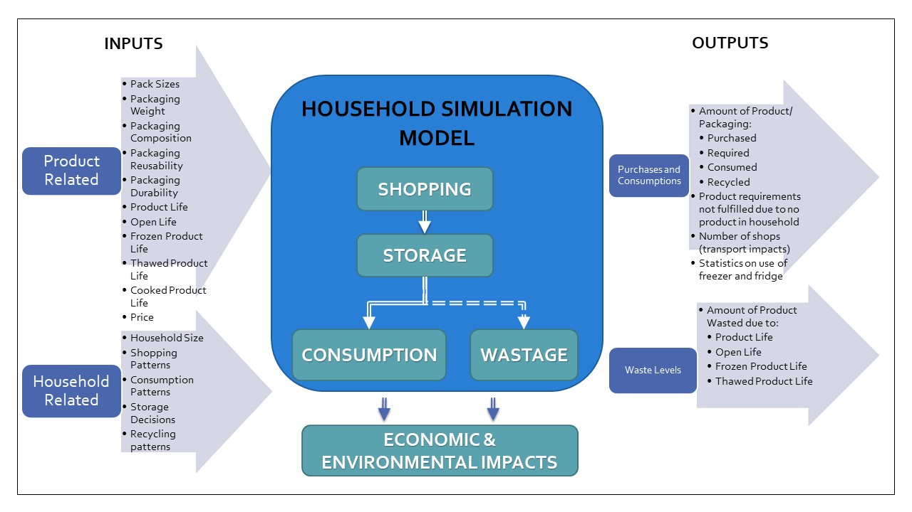




The household simulation model

Slide 35
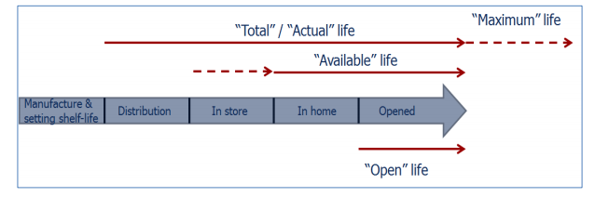

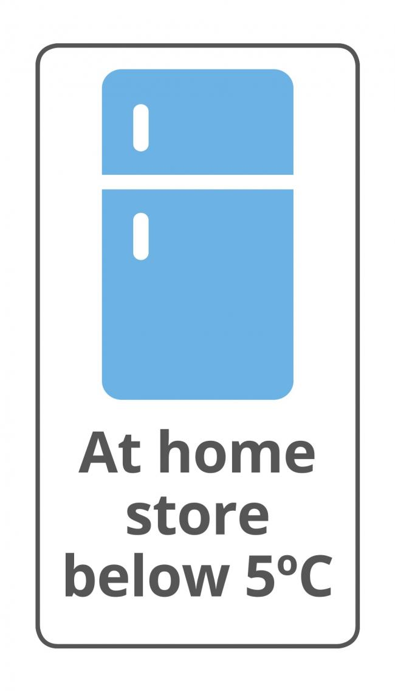
The HHSM can test many innovations
Packaging type and shelf life
Portion sizes and package size
Storage impact
Reusable, recyclable or compostable – impacts on design
Changes to the packaging type/shape/reusability/durability.
Effect of food/packaging innovations
(including technologies to increase product life, changing date labelling, optimising storage and packaging, use of fridge and freezer, pack and portion size optimisation, shopping optimisation, leftover use, cooking practice, and general consumer practices)

Slide 36
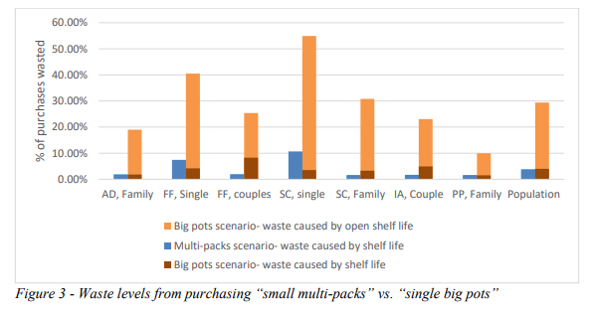
Change packaging size – Results 25% waste decrease

Slide 37
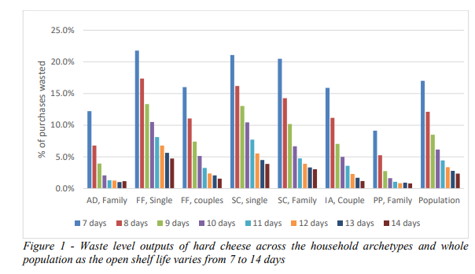
Change product life – Results 15% waste decrease

Slide 38
Change packaging – (from Masters student project)
Normalised (per year) results for Global warming (kg of CO2e) in the Aspirational Discoverers family chicken breast scenarios, for two packaging trade-off scenarios in the AD family buying 100% plastic bag or 100% plastic tray packaging for 500g.

Slide 39
Chicken breast – increase product life +1 or +3 days
There is about a one percentage point drop in the ‘+1 day’ (e.g. 7% to 6% for FF Single and 2% to 1% for PP Family) and a two percentage drop in the ‘+3 day’ scenario (leading to practically no waste at all in this scenario for the larger households).

Slide 40
Chicken breast – change product size “large” or “exact”
Waste is higher when larger packs of chicken are purchased, reaching upwards to 20-25% for FF Single and SC Single.
Only three of the seven households participate in the ‘exact needs’ scenario (FF Single, SC Single, and SC One Child). These three households have the highest ‘default’ waste rates, which are substantially reduced (i.e. by about than 70%) when enforcing purchasing of only the amount needed.

Slide 41
Chicken breast – Use AND freeze leftovers
Waste of chicken increases about 3.5x (from an average of 3.7% to 12.5%) when use of leftovers is modelled.
Why should using what remains from one meal as part another meal see more waste? (no freezer use) Splitting that waste into its constituent elements highlights most of this increase is from greater waste from expiration (9.6%).
When the freeze option is turned back on, we see the impact of using leftovers relative to the default scenario. Waste falls in all but one household; by about 20% in high default waste archetypes and about 3% for low default waste archetypes. An unexpected result based on the pattern of other households is the 4% increase in waste by IA Couple.

Slide 42
Results - an Evidence Matrix
https://www.wrap.org.uk/sites/files/wrap/Retail_Survey_2019.pdf

Slide 43
Actions to reduce meat waste at home (UK)
We can make further actions and innovations to reduce household meat waste.
These actions can be take “up” to supply chain, as well as in households (behaviour).
https://wrap.org.uk/sites/default/files/2020-07/WRAP-Meat-in-a-Net-Zero-world-publication.pdf

Slide 44
Take Away points
Global meat loss and waste is an important issue – from both a carbon and economic perspective.
Food waste does not happen where the carbon is emitted in the food system.
We need to reduce household food waste AS WELL as decarbonise food production
All countries have different drivers for household meat waste.
Different types of meat product have different drivers for waste.
There are a range of solutions that producers (and households) can use to reduce meat waste including:
  Shelf life and storage temperature improvements
  On-pack information communication
  Product and portion size change
  Wider behaviour changes (leftovers, freezer, shopping habits etc.)

Slide 45

Please do get in touch
  Dr Christian Reynolds
  Centre for Food Policy, City, University of London
  @sartorialfoodie christian.reynolds@city.ac.uk
The Centre for Food Policy, City, University of London offers the following courses
Nutrition and Food Policy BSc (Hons)
Undergraduate degree
Food Policy MSc/PGDip/PGCert/MSc Distance Learning
Postgraduate taught degree
PhD/MPhil Food Policy
Postgraduate research degree
https://www.city.ac.uk/prospective-students/courses/postgraduate/food-policy
Many thanks to my many collaborators.
This work was funded by This work was supported by the Economic and Social Research Council; Natural Environment Research Council [NE/R007160/1 and NE/V010654/1]; and the Waste and Resources Action Programme.

