Slide 1
Alternative food systems for urban food security
Dr Christian Reynolds
@NutritionSoc #ISN2022

Slide 2

Alternative food systems for urban food security
Informal Working Group Meeting- 13 January 2022

3rd International Symposium on Nutrition (ISN 2022): Urban Food Policies for Sustainable Nutrition and Health
27th January 2022
15:45-16:10 GMT/UK
Dr Christian Reynolds
Centre for Food Policy, City, University of London
@sartorialfoodie @NutritionSoc #ISN2022
christian.reynolds@city.ac.uk

Slide 3










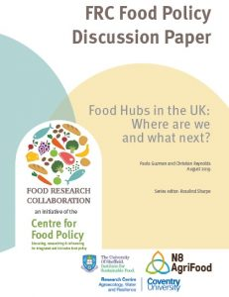
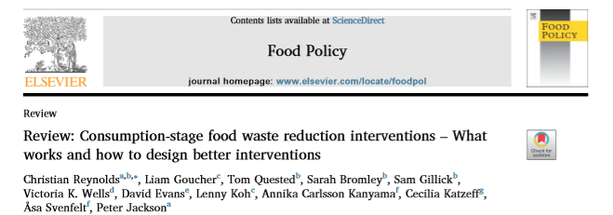
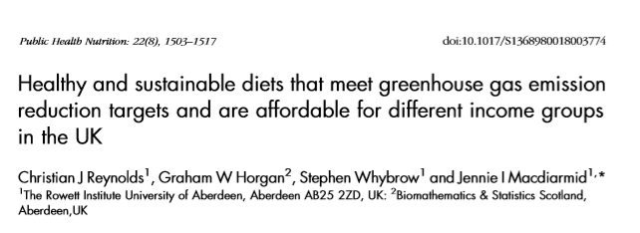
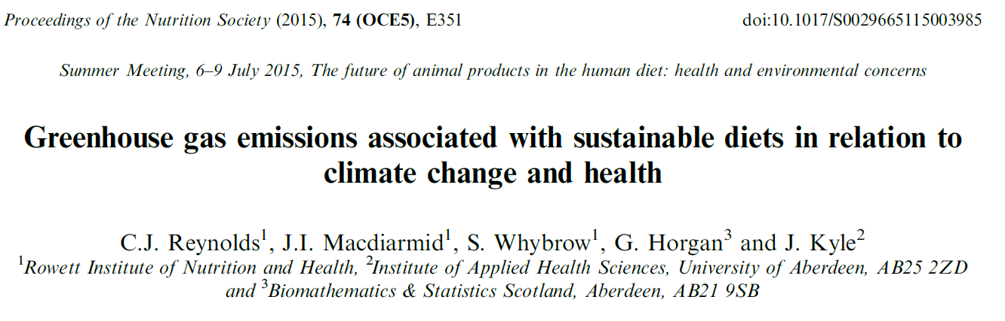
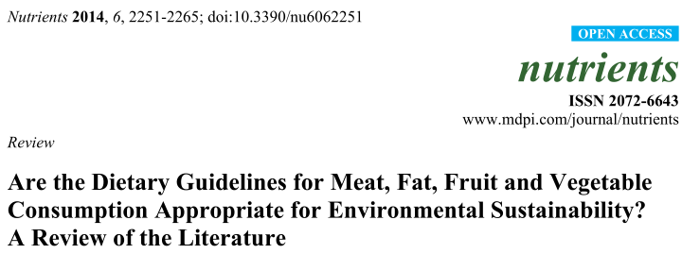
Who am I? – Christian Reynolds
Senior Lecturer at the Centre for Food Policy
Focus: healthy sustainable diets and food consumption (including waste)
Previously: Food waste politics/history, social sciences approaches

Slide 4
Todays talk
The promise and the reality of local food.
How alternative food bridges the gap between many food systems
2020 was a transformation point for the complexity of alternative local food systems
Specific operations for food security in alternative local food systems
  Food Hubs
  Community Fridges

Slide 5
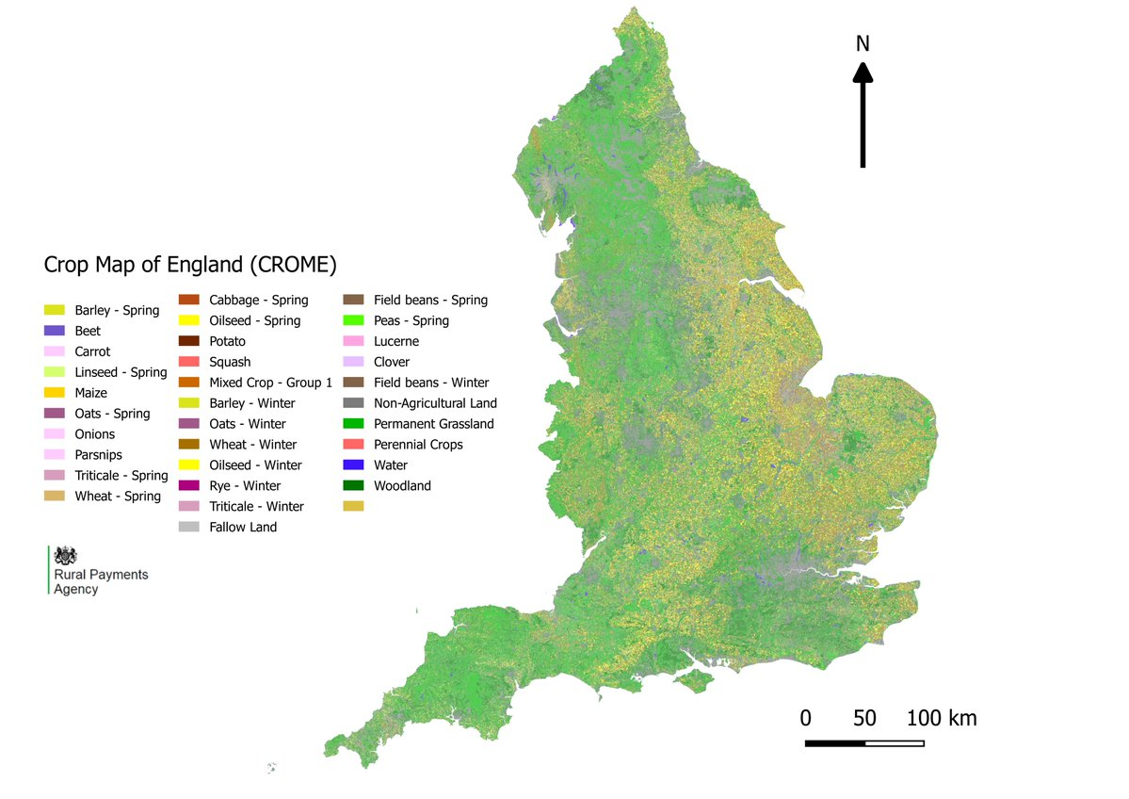
Brexit, Covid and (urban) food security...
What is a “local” diet?
The UK is currently importing over 50% of its food and feed.
70% and 64% of the associated cropland and GHGE impacts are located abroad.
Area UK supply
Veg: 1390 km² 54%
Fruit : 294 km² 17%
UK urban areas cover >21,500 km2 – approx. 50% is greenspace… could this be used for food?
Supply chain complexities? Milling, abattoirs, etc.
https://data.gov.uk/dataset/be5d88c9-acfb-4052-bf6b-ee9a416cfe60/crop-map-of-england-crome-2020

Slide 6
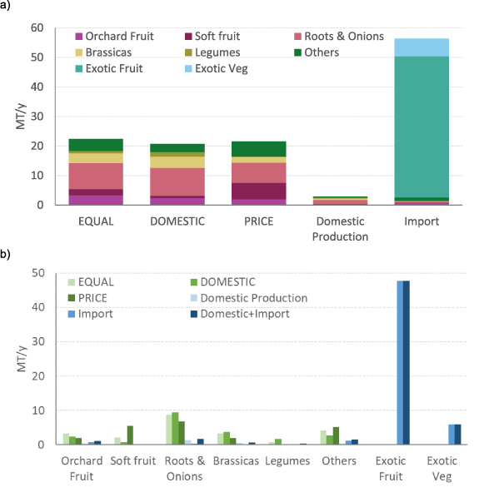
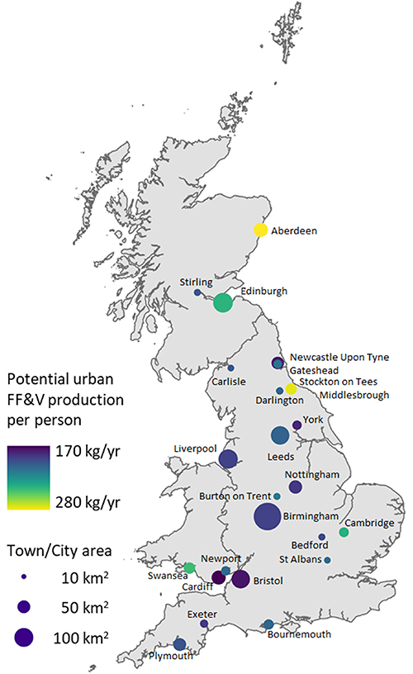
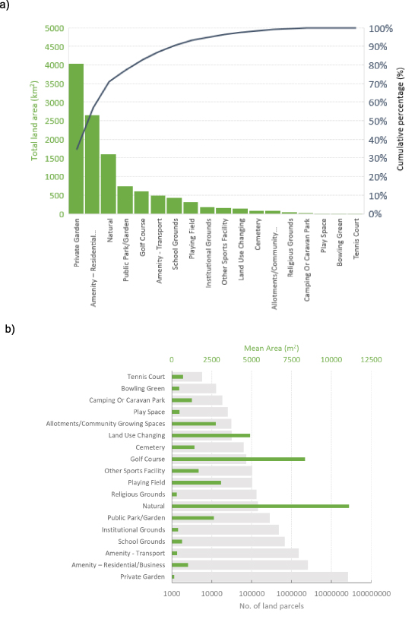
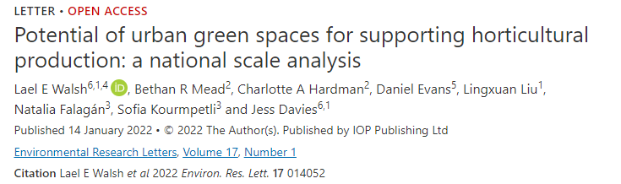
Potential: urban spaces for food
Figure 2. Estimated national production potential of FF&V expressed as MT per year (MT yr⁻¹) for GB green spaces compared with domestic production and imports. Section 2.3 further described that estimates were based on three options. (a) Total production per land allocation: equal-split option. (b) Breakdown by crop category: domestic-poduction option. (c) Breakdown by economic value: price-option.
Characteristics of green space in GB.
Comparison of the green spaces in GB by total area and as a cumulative percentage of the total green space area (in km²) across England, Wales and Scotland.
Total number of land parcels in each category and their mean area (in m²).
Figure 3. The location of 26 GB towns and cities analysed for their urban FF&V production expressed as kg per year (kg yr⁻¹) in relation to town and city size.
https://doi.org/10.1088/1748-9326/ac4730

Slide 7
Potential: urban spaces for food
Figure 2.
Potential urban FF&V production expressed as kg per year (kg yr⁻¹) in relation to town and city size.
Figure 3. The location of 26 GB towns and cities analysed for their urban FF&V production expressed as kg per year (kg yr⁻¹) in relation to town and city size.
Estimated national production potential of FF&V expressed as MT per year (MT yr⁻¹) for GB green spaces compared with domestic production and imports.
https://doi.org/10.1088/1748-9326/ac4730

Slide 8
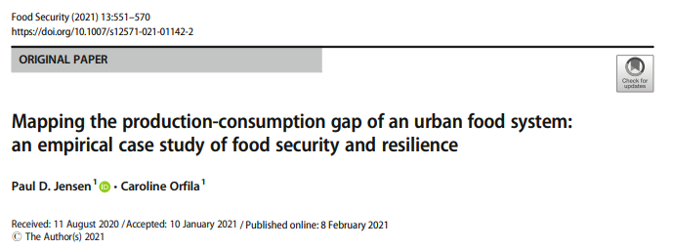
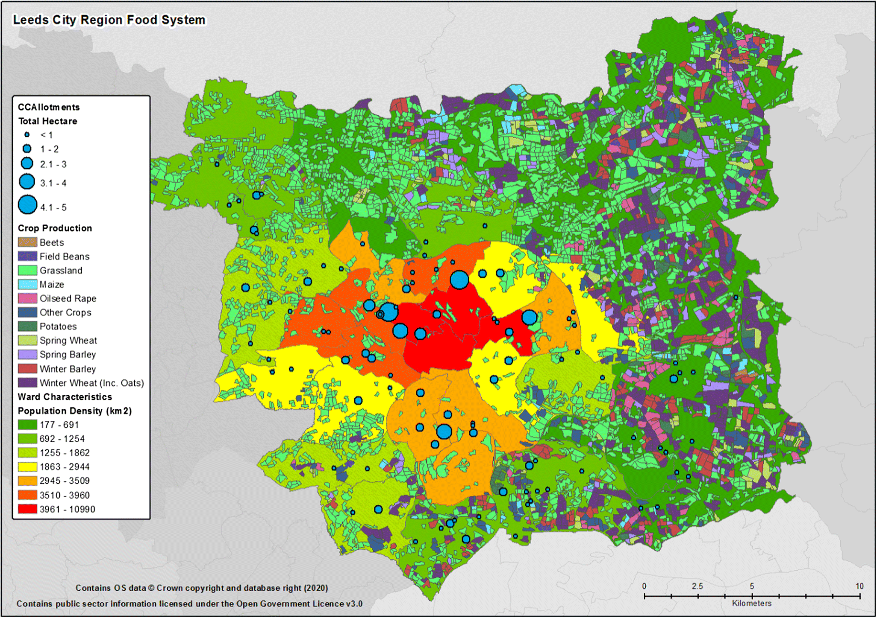
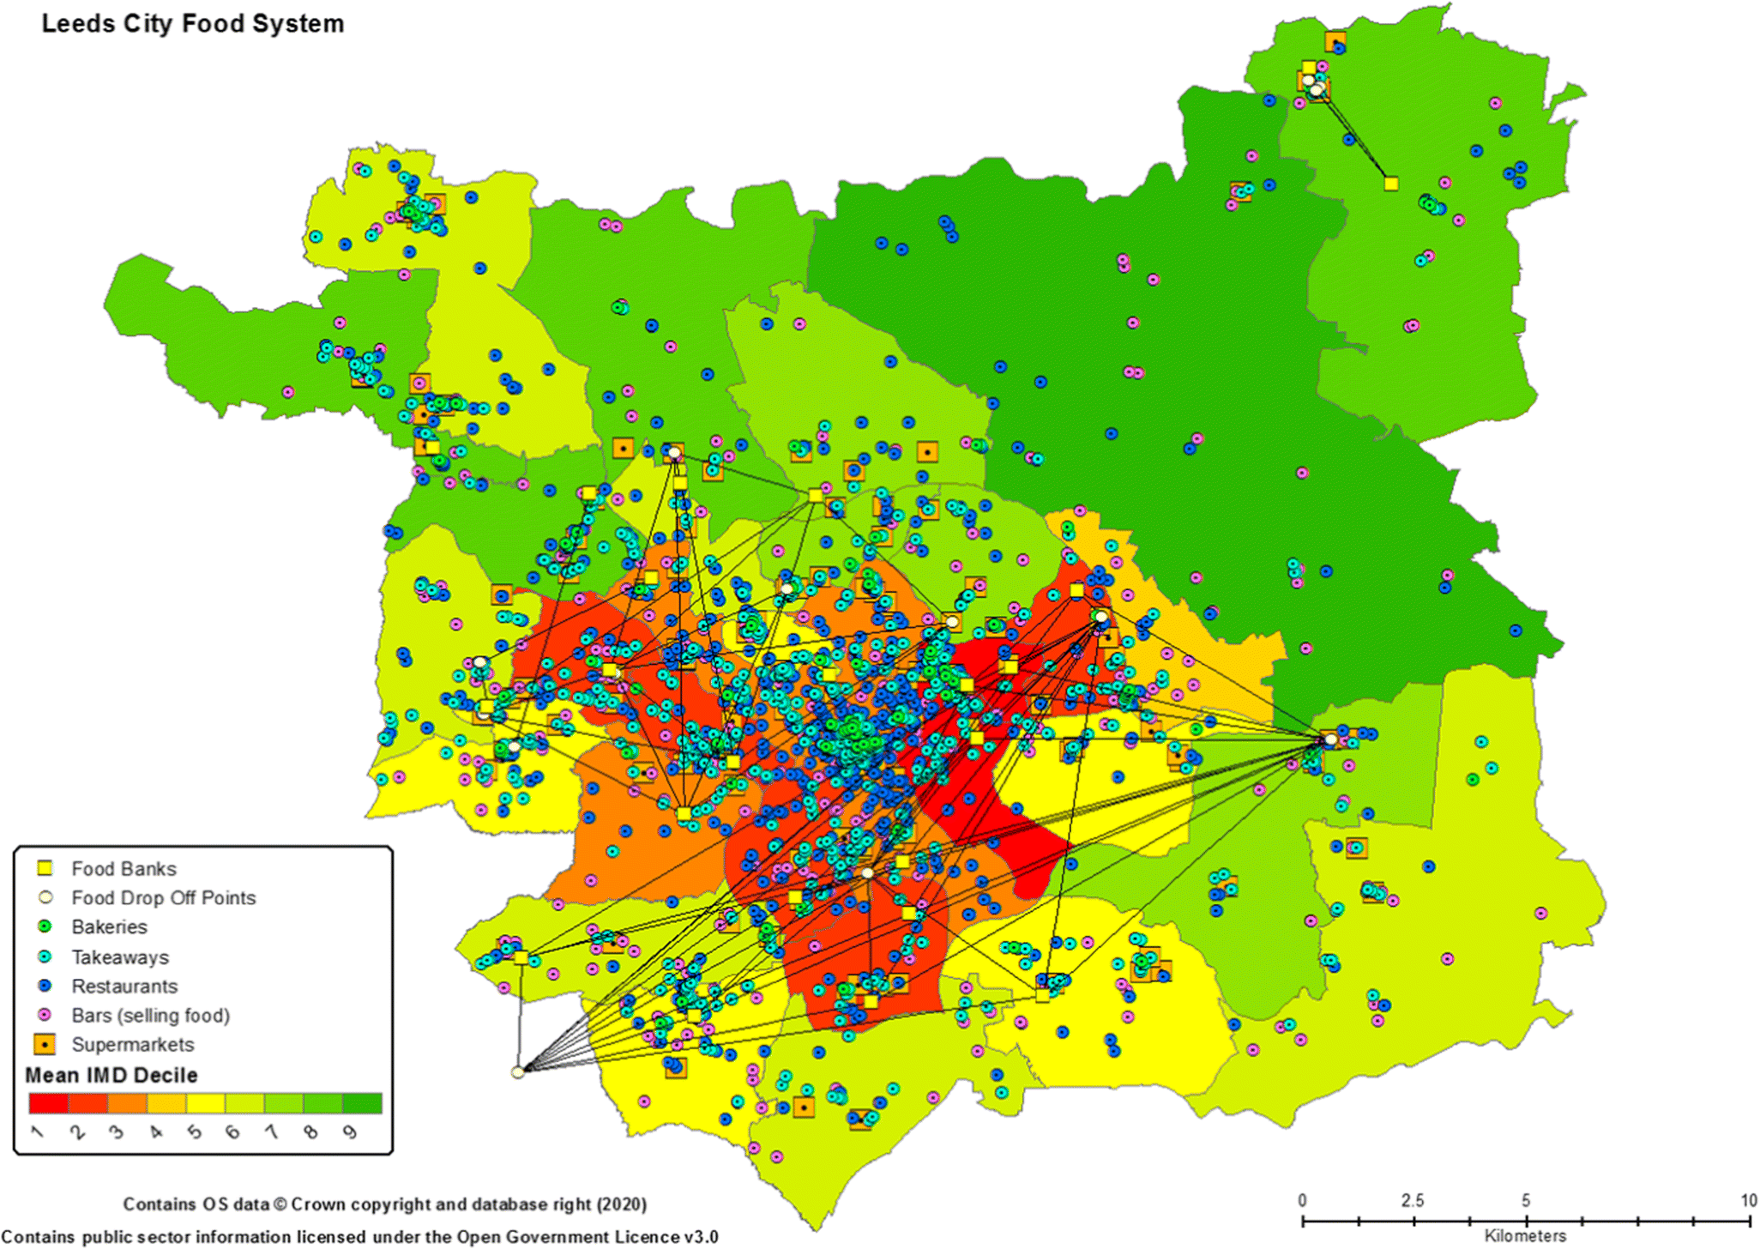
Currently no City in the UK can be self sufficient…
But understanding “local” alternative food systems can make a difference to HOW we feed ourselves.
Production environment Consumption environment
Leeds – case study

Slide 9
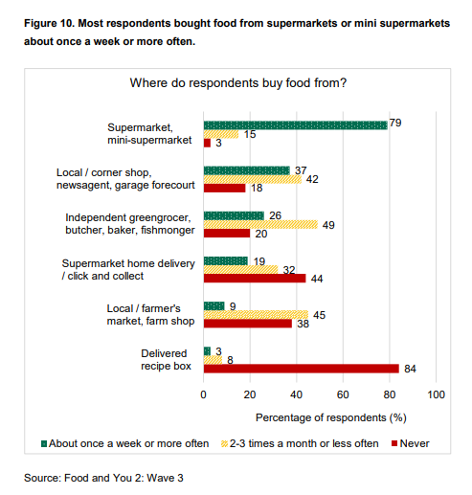
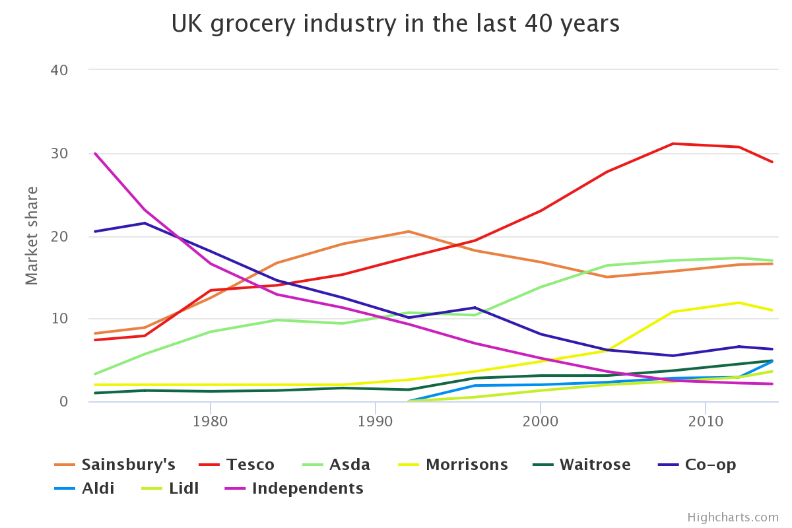
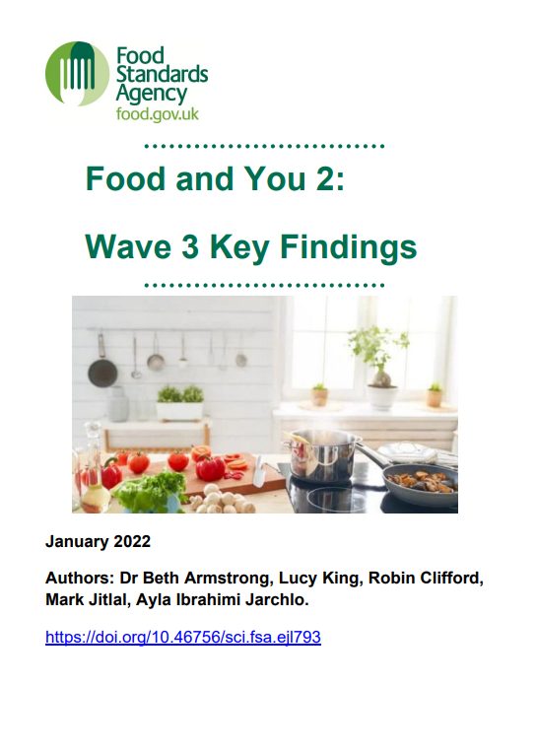
How (and where) we purchase food is always changing.
Alt. food is part of the system.
UK % market share of supermarkets – Groceries market (yearly average values).
Sources, Kantar, IGD http://www.fooddeserts.org/images/supshare.htm, http://www.telegraph.co.uk/finance/newsbysector/retailandconsumer/11057120/The-rise-and-fall-of-British-supermarkets.html
Sample Jun 2021, published Jan 2022
https://www.food.gov.uk/research/food-and-you-2/food-and-you-2-wave-3

Slide 10
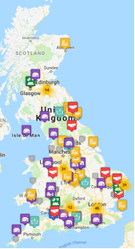
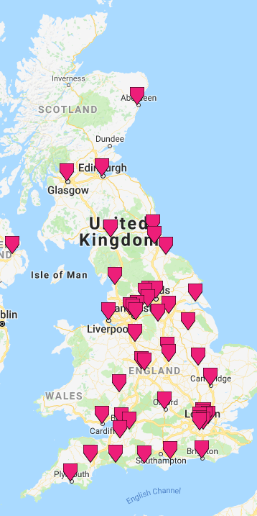
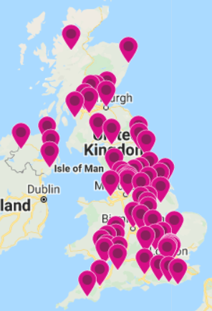
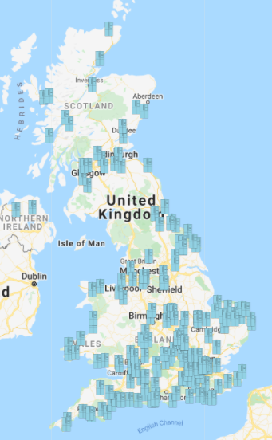
2018 to 2022 New alternative food systems emerging
Alternative Local food systems are growing in a wider number of UK places
Sustain food co-op finder (2018)
Sustainable Food Cities (2018-2019) n=~ 50
Sustainable Food Places
(2022) n=~ 69
Community Fridge network
(2022) n=~ 250

Slide 11
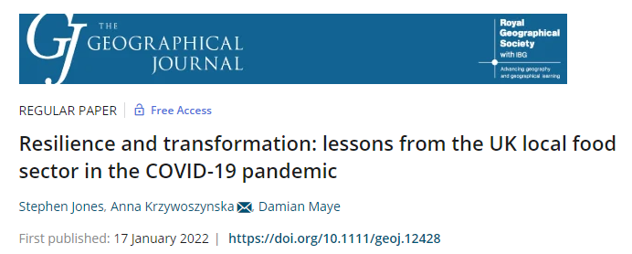
2020 a transformation point for alternative local food in resilience and complexity
Pre 2020 alternative local food eco-systems:
farmers’ markets, community supported agriculture, box schemes, consumer co-ops, producer co-ops, grow your own, local shops, farm shops and public procurement
Post 2020 alternative local food eco-systems :
box schemes, local independent shops, community supported agriculture projects, grow your own schemes, farm shops, farm gate sales, local markets, farmers’ markets, procurement schemes, online direct sales platforms, community gardens, food hubs, food partnerships
Alternative local food eco-systems are developing in complexity.
Due to existing structures, but COVID-19 gave space for growth
https://doi.org/10.1111/geoj.12428

Slide 12
2020 a transformation point for alternative local food
Why were local food systems able to adapt?
Flexibility;
Speed, or rapidity,
Existing Social capital and teamwork;
Diversity (of audience and product);
Ability to scale…
but scale only so far…
“So in the space of 2 weeks we went from 370 orders to 550 and it only stopped at 550 because we turned off the website and prevented new people from signing up” (Box Scheme)
Further barriers to scale
Limited consideration of the potential role of local food in the policy sphere.
Does Local food have the ‘wrong kind’ of social capital to enter mainstream policy debates
https://doi.org/10.1111/geoj.12428

Slide 13
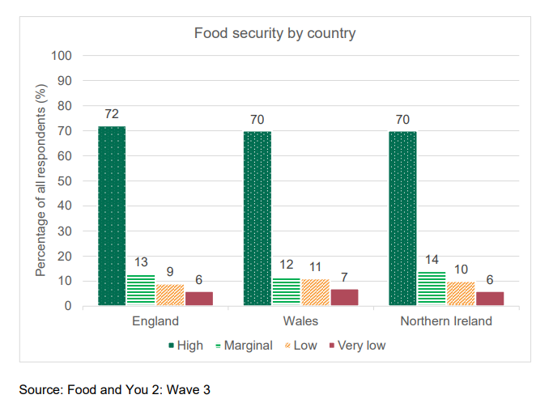
Alternative food systems and food security
Across England, Wales, and Northern Ireland, 85% of respondents were classified as food secure (72% high, 13% marginal) and 15% of respondents were classified as food insecure (9% low, 6% very low).
Sample Jun 2021, published Jan 2022
https://www.food.gov.uk/research/food-and-you-2/food-and-you-2-wave-3
As shown by their response to COVID-19, alternative local food systems can play a crucial role in food security and food system resilience. Two operation types of note:
• Community Fridges • Food Hubs

Slide 14
Community fridges
“A Community Fridge is a social space that brings people together to eat, connect, learn new skills and reduce food waste.”
“A Community Fridge can be accessed by anyone and everyone who wants to share food, volunteer or get involved with other food, environment or related activities the group have to offer.”
https://www.hubbub.org.uk/the-community-fridge#find
2016 – charity Hubbub trialed the concept in Derbyshire, UK. (similar schemes in other countries like Spain and India, but none existed in the UK.).
2017 – to meet this demand, Hubbub founded the Community Fridge Network to help any individual or group to set up and run safe, inclusive and impactful fridges.
2022 – now a 250 strong network with funding for an additional 250 fridges from a supermarket
Community Fridge Network (redistributes the equivalent of over 17.1 million meals* (over 7,200 tonnes of food surplus) to over 460,000 visitors each year.
Each fridge sharing an average of 2.4 tonnes of food per month,
Community Fridge network
(2022) n=~ 250
Mainstream
Alternative
Supermarket surplus
Local food sources
Community fridge

Slide 15
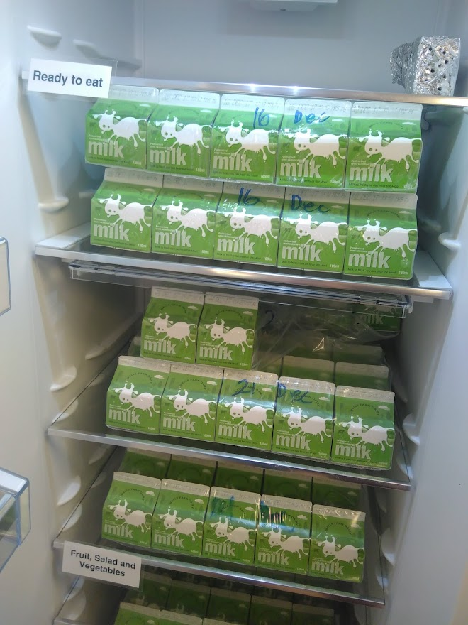
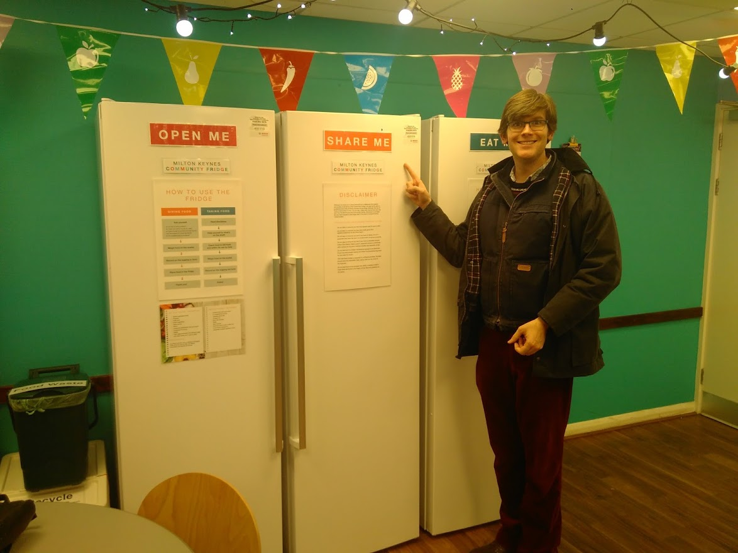
Community fridge field work (2017)

Slide 16
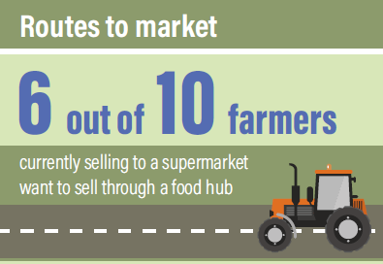
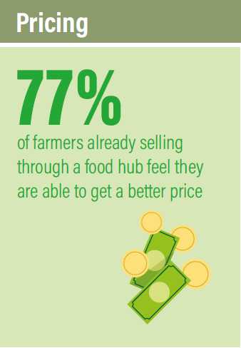
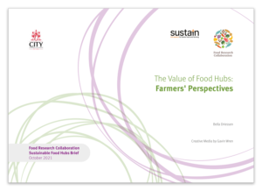
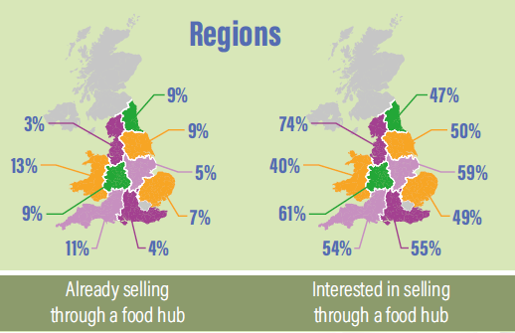
Food Hubs
“Food hubs are entities that sit between people who produce food and people who eat it, gathering food from growers and distributing it either to commercial customers or directly to consumers.
They can fill gaps in local food infrastructure, help consumers find locally sourced produce, support new forms of food retail, incubate food enterprises, or create a space for community education and action.”.
Paola Guzman and Christian Reynolds , Food Hubs in the UK: Where are we and what next?
N=30 food hub survey in 2017/18
https://foodresearch.org.uk/publications/food-hubs/

Slide 17
Food Hubs – a farmer perspective
”Food hubs, as a route to market, are largely seen as an opportunity to increase farm incomes, improve logistics and broker and maintain commercial relationships.
There is also a strong belief that food hubs could help farmers improve animal welfare. There is a connection, though weaker, between selling through food hubs and delivering climate- and nature-friendly farming.
Direct sales are seen by farmers to provide much greater opportunities for enhancing the environmental impact of farms. The surveyed farmers strongly believe that their food can be sold locally, but feel they lack the infrastructure, time and money to change their route to market.”
The Value of Food Hubs: Farmers' Perspectives
Bella Driessen & Creative Media by Gavin Wren
n=500 farmer survey
https://foodresearch.org.uk/publications/the-value-of-food-hubs-farmers-perspectives/

Slide 18
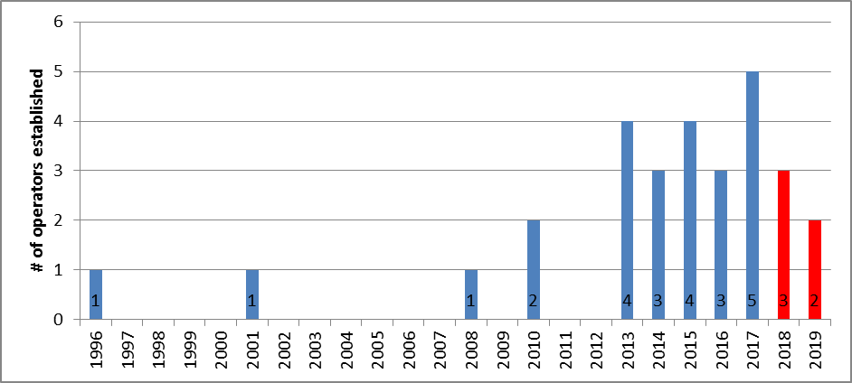
Food hubs, Years of operation as of 2017/18
Growth of operators (post 2013) in keeping with the global resurgence of alternative, local, sustainable, and community food movements. N=30

Slide 19
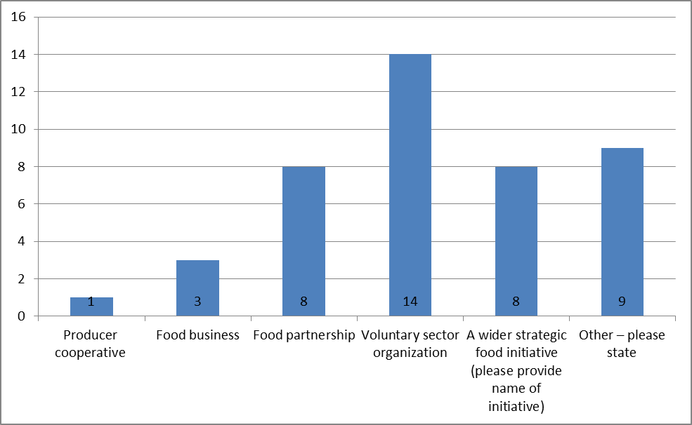
The development/set up of food hub instigated by…

Slide 20
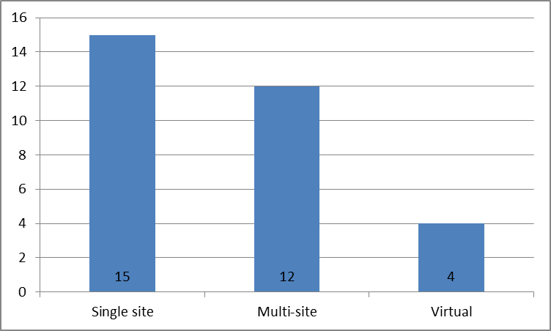
Type of operation
Over half (15) of the operators ran single sites, with the remainder being multi-site (12), or entirely virtual operations (4).

Slide 21
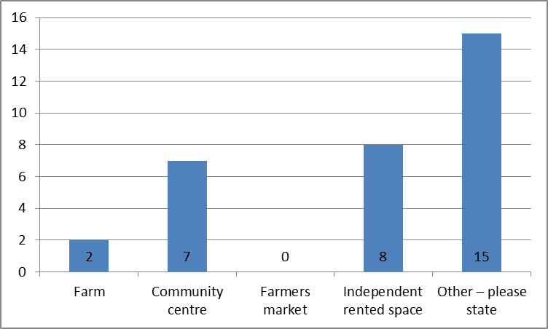
There is not one typical type of food hub premises

Slide 22
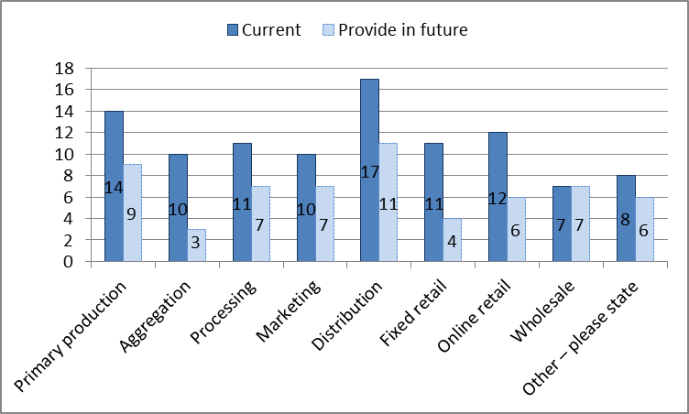
Supply chain functions vary based on the hubs objectives
The supply chain operation fulfilled (and aspired to) by the hubs are varied due to the differing roles and objectives of each operation. The most common supply chain operation was distribution of food (Including redistribution of surplus and food waste)

Slide 23
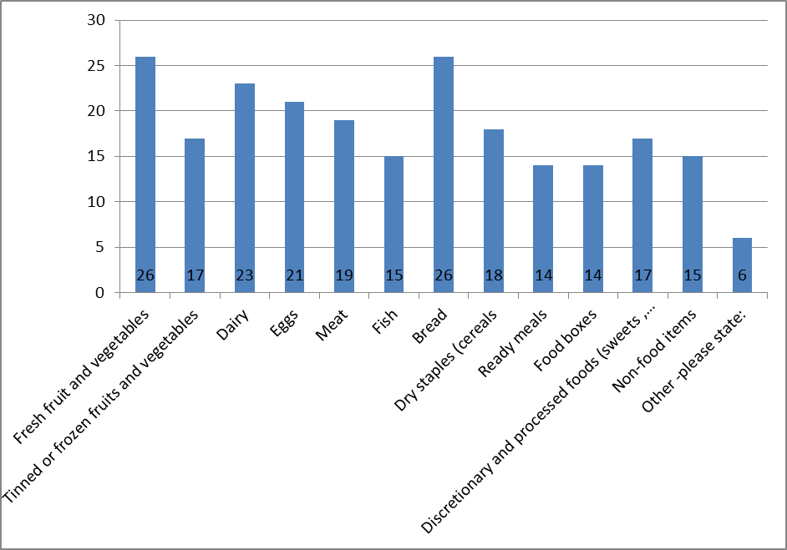
Types of food on offer … more than just fruit and veg
(Shift towards higher profit items/complex foods (high labour) in established hubs)
Online shopping available at 1/3rd of hubs

Slide 24
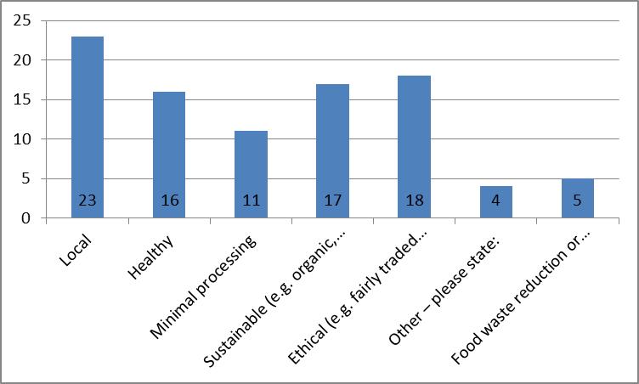
Hub ethos varies but similar, multiple, and overlapping

Slide 25
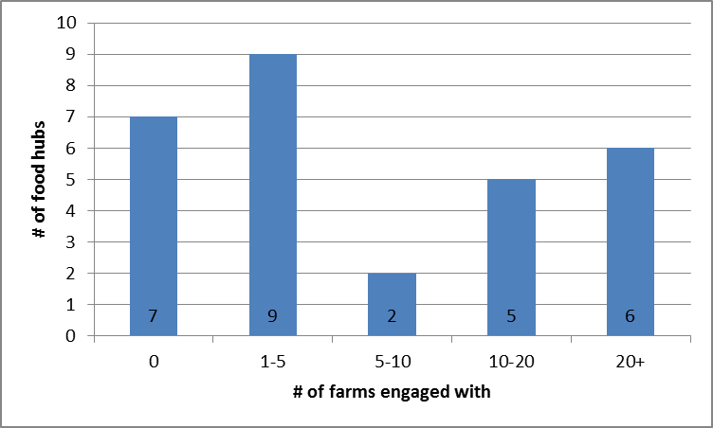
Number of farmers engaged with depends on type and ambition of hub

Slide 26
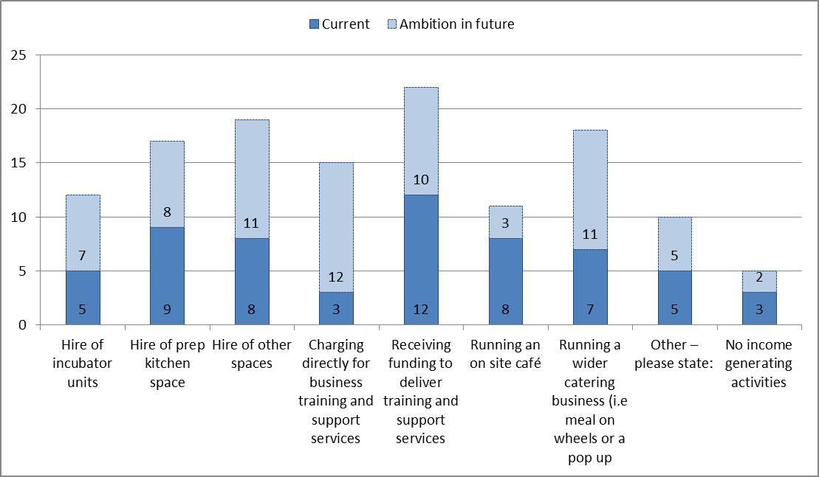
Commercial income activities (beyond those derived directly from food supply/retail functions)

Slide 27
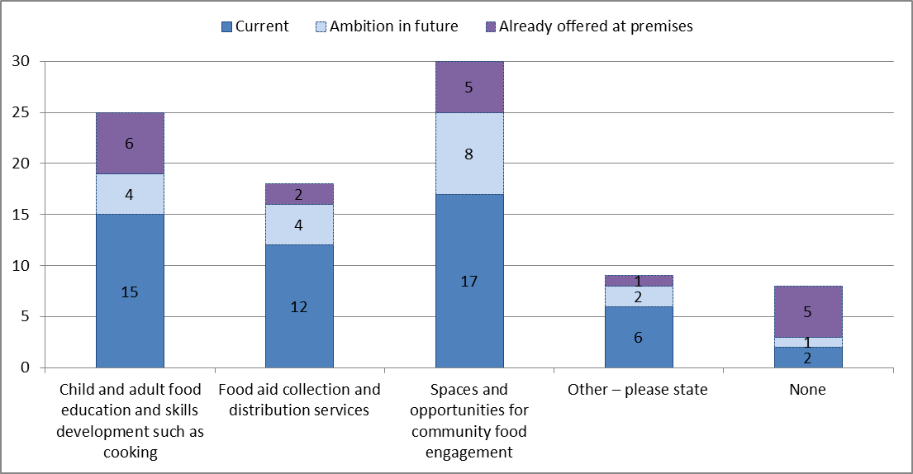
Non-commercial functions are important

Slide 28
In Summary…
Local food systems could provide much more food to UK/urban communities
Current local alternative food systems are complex with many organisation types
This complexity provides resilience and has allowed for an different response to COVID-19 and Food Security issues
Alternative local food systems can play a crucial role in food security and food system resilience. Two operation types of note:
• Community Fridges • Food Hubs

Slide 29

Please do get in touch
  Dr Christian Reynolds
  Centre for Food Policy, City, University of London
  @sartorialfoodie christian.reynolds@city.ac.uk
The Centre for Food Policy, City, University of London offers the following courses
Nutrition and Food Policy BSc (Hons)
Undergraduate degree
Food Policy MSc/PGDip/PGCert/MSc Distance Learning
Postgraduate taught degree
PhD/MPhil Food Policy
Postgraduate research degree
https://www.city.ac.uk/prospective-students/courses/postgraduate/food-policy
Thanks to the many research collaborators, and the wider alternative food network communities for engagement since 2015.

