Slide 1


Frames, models and definitions: rethinking information literacy for the digital age
Dr Jane Secker
Senior Lecturer in Educational Development, City, University of London
Creating Knowledge Conference – Tromso - 4th June 2021
Notes:
Good morning, I am delighted to be giving this keynote.

Slide 2
What am I talking about?
Expanding the definition of IL
Advocating for IL outside the library
Collaboration & partnerships
Information literacy in higher education
Notes:
What am I talking about and why should you care?

Slide 3
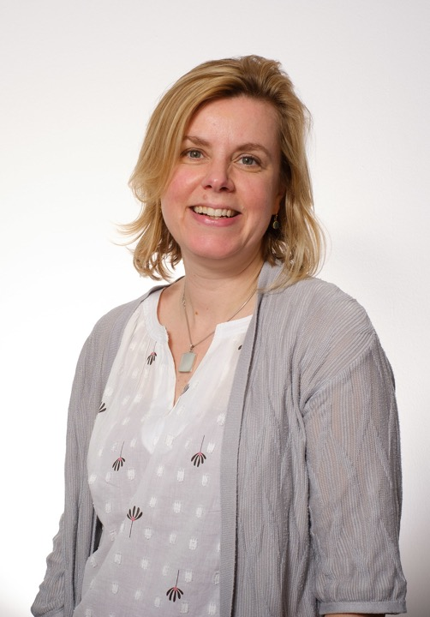
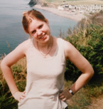






Notes:
Jane

Slide 4
WHY
DO I CARE
ABOUT
INFORMATION
LITERACY?

Slide 5
Meeting Paul Zurkowski
”People trained in the application of information resources to their work can be called information literates. They have learned techniques and skills for uti- lizing the wide range of information tools as well as primary sources in molding information solutions to their problems”
Zurkowski (1974)

Slide 6
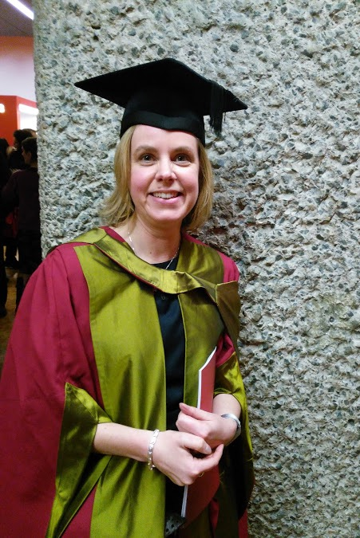
What do educational developers do?
Advise on curriculum design and development
Staff development for academics / faculty
Teach on PGCert / Masters in Academic Practice
Support academic staff getting professional accreditation

Slide 7

Conversations about information literacy

Slide 8
EDM122: digital literacies and open practice
Background and overview
  Part of MA in Academic Practice at City (15 credits) launched in October 2018
  3 cohorts including one fully online from October 2020
  Informed by module: Open Knowledge in HE at University of Manchester (part of their PGCAP)
  Built on experience of teaching Copyright Literacy and Open Practice teaching at the Universidad de la Republica Uruguay in August 2018
https://blogs.city.ac.uk/dilop/

Slide 9
Researching academic perceptions
Explored staff attitudes and experiences of digital literacies and open practice and their teaching
6 Semi-structured interviews undertaken in summer 2019.
Used phenomenography to understand the variation in experiences
Findings focused on staff motivations, student abilities, challenges and role of staff development
Secker, (2020)
Notes:
The overall aim of this project is to answer the following questions:
What is the experience of staff who use educational technologies and how do their attitudes towards digital literacies and open practices impact on their teaching?
How are staff currently supported to develop a good understanding of these literacies and practices as part of these two modules which form part of the MA in Academic Practice at City, University of London and what additional support might they need?
To achieve the above aim, the project will specifically examine the following sub-questions:
How do staff define terms such as digital literacies and open practice?
What support do they need to develop their own (and their students) digital literacies and what is the role of EDM122 and the EDM116 module in supporting them?
What attitudes do they have towards the concept of ‘openness’ in their teaching?
Do they share their teaching or research materials openly and how do they make decisions about re-using others and licensing their own work?
What changes might they have made to their teaching or research practices since completing the two modules and how is this impacting on their students or beyond?

Slide 10

Terminology is confusing…
Notes:
Genuine confusion about terminology but a recognition that creating independent learners was challenging
Digital literacies are….
Both personal (for life) and professional (for job)
Discipline specific and contextual
Related to organizational changes
Essential to use educational technologies effectively but sometimes equated to technical skills

Slide 11
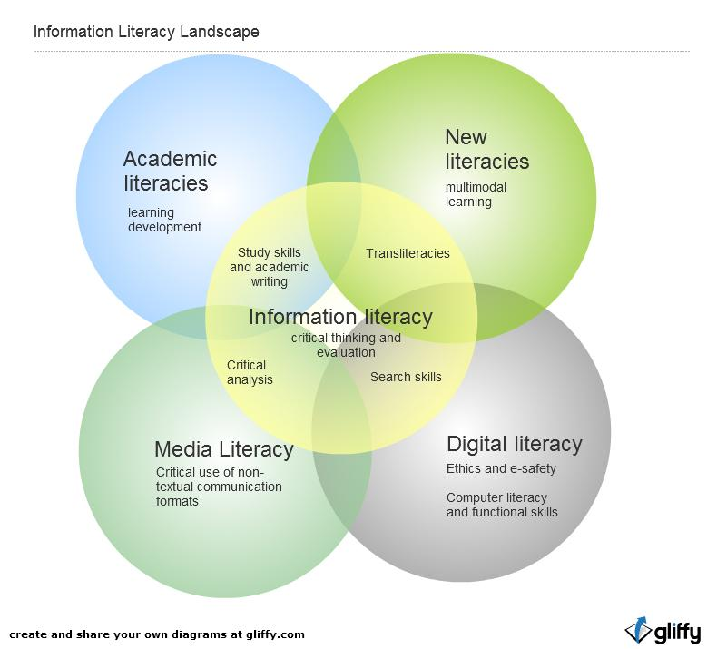

Slide 12
What I’ve learnt from teaching information literacy
It’s complex and dangerous to make assumptions about what people know or what students want or need
Many teachers and academics do care but don’t understand how to foster these abilities in students
Concealing complexity helps users but is problematic
We need ways to expose information structures and privilege
Notes:
And here is where librarians might have inadvertently made things worse– you make information accessible and discoverable and that is IL .
This slide is a curtain – I call it the librarians velvet curtain. We spend a LOT of time concealing the complexity of information, in our bid to make it manageable, discoverable, more accessible.
We build authentication systems so many of our users get seamless access to our resources. I am not saying we want to make it complicated – but by concealing the complexity we sometimes don’t help ourselves.
Our resources don’t get used if our systems are too complex

Slide 13




The CILIP Information Literacy Group
https://informationliteracy.org.uk
Notes:
Founded in 2004
Special Interest Group of CILIP
Over 1000 members
Run the LILAC Conference
Run the website and blog informationliteracy.org.uk
Run the Journal of Information Literacy

Slide 14

Information Literacy is……
“…the ability to think critically and make balanced judgements about any information we find and use. It empowers us as citizens to develop informed views and to engage fully with society.”
CILIP Definition of Information Literacy 2018
Notes:
So I have thought about IL for quite a long time and why it’s important, how to support IL and develop it in students and others. And of course why it matters. I wouldn’t be chair of the IL group if I didn’t think it matters.

Slide 15





5 Contexts of Information Literacy
Everyday life
Citizenship
Education
The Workplace
Health

Slide 16

Taking IL beyond the library is challenging

Slide 17
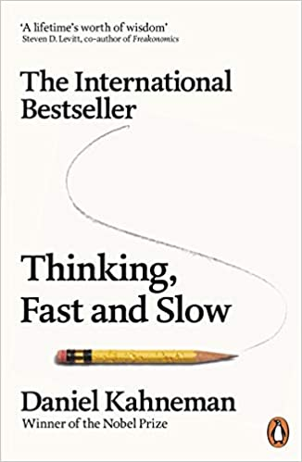
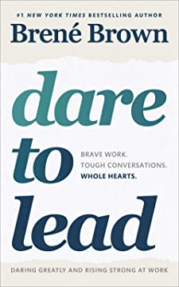
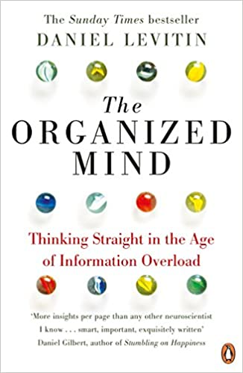
Taking IL beyond the library is challenging

Slide 18


What role do frameworks and models play in advocacy?

Slide 19
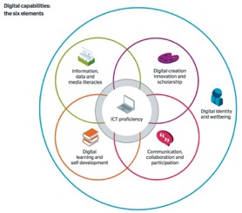
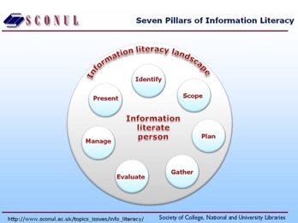
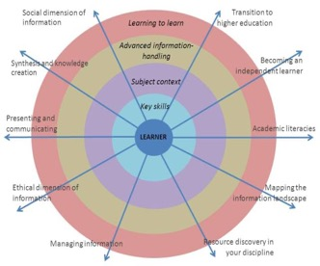
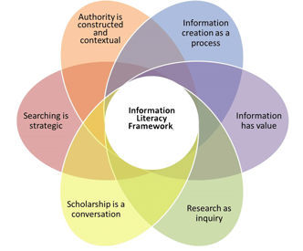


Slide 20
Designing a new framework for IL
Our aspirations
Examples of what these look like
Competencies / know how to achieve these
A framework to support / scaffold development
Learning outcomes
Notes:
Be healthy [encompasses health literacy, financial health]
- Be informed [encompasses media literacy, data literacy]
- Be connected (safe/aware) [encompasses internet safety, digital literacy]
- Be socially conscious [encompasses diversity and inclusion, ecology, ethics and respect of others including their work and ideas]
- Be better

Slide 21
Who owns information literacy?
Notes:
Collaboration – it’s an easy word to say, but a difficult thing to make happen in practice for all sorts of reasons
Tribes and territories and crossing professional boundaries
People just not getting on / seeing things from the same perspective
The need for inter disciplinary – the need to do research in messy, liminal spaces

Slide 22


Media and Information Literacy Alliance
Media and information literacy play an increasingly central role in enabling people to lead healthy, productive lives in an increasingly connected world. Responding to the Government’s proposals to develop a new Media and Information Literacy Strategy, CILIP and the Information Literacy Group (ILG) have agreed to form a new Media and Information Literacy Alliance, to be launched during Summer 2021.

Slide 23
Information skills for life
Early years intervention
Primary, Secondary & FE provision
Higher Education
Post-16 & adult education
Information in the workplace
Lifelong learning & active ageing
Information skills for life & citizenship
We believe that information literacy is essential to leading a happy, healthy and successful life in our information society.
We are committed to a ‘lifetime’ model of information skills, from early years intervention through to lifelong learning and active ageing.

Slide 24
Information Literacy Alliance Theory of Change (Weiss, 1995)
Time
Energy
Capacity
Money
Definition
Expertise
Shared values/purpose
Advocacy
  Partnership-building
  Public/media engagement
  Political engagement
Research & development
  Developing an impact framework for IL
  Alignment of existing models and approaches
  Mapping existing activity
  Developing an evidence- based
Capacity-building
  Knowledge hub
  Practitioner training
  Embedding into curricula (LIS & related)
  Networking
Interventions
  Targeted projects
  Evaluation
  Policy development
Enhanced awareness of and engagement with information and information literacy as a key aspect of people’s daily lives.
Better-coordination of efforts across multiple domains to promote information literacy.
Better alignment between different ‘types’ of information literacy (including media and digital literacy and citizenship).
A stronger evidence-based to inform future policy and practice.
A pathway to ‘operationalise’ and evaluate effective interventions to support lifelong learning and combat misinformation.
A more productive dialogue between media, regulators and policymakers over the legislative basis of information use.
Every citizen is empowered to engage critically with information and to harness it to support their own lifelong learning.
Formal and informal education is richer, broader and more balanced.
Information providers are more accountable and provide access to a broader and more balanced range of information resources.
Democratic institutions are more accountable for their promotion and use of information.
Businesses benefit from a more information-literate workforce with better analytical skills and the ability to make better use of information.
People lead healthier, happier and more productive lives
Our democratic system is more resilient, future-proof and effective.
Our economy is strengthened through enhanced productivity and innovation.
Our society is more equitable, just, inclusive and representative.
INPUTS
ACTIVITIES
OUTPUTS
OUTCOMES
IMPACT
Notes:
Theory of Change is a rigorous yet participatory process whereby groups and project stakeholders identify the conditions they believe have to unfold for their long-term goals to be met.

Slide 25
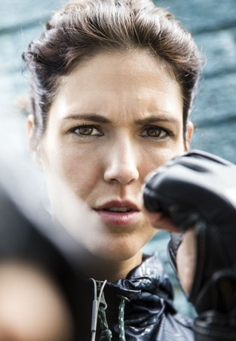


Rethinking Information Literacy
Advocate
Collaborate
Inclusivity and connection

Slide 26
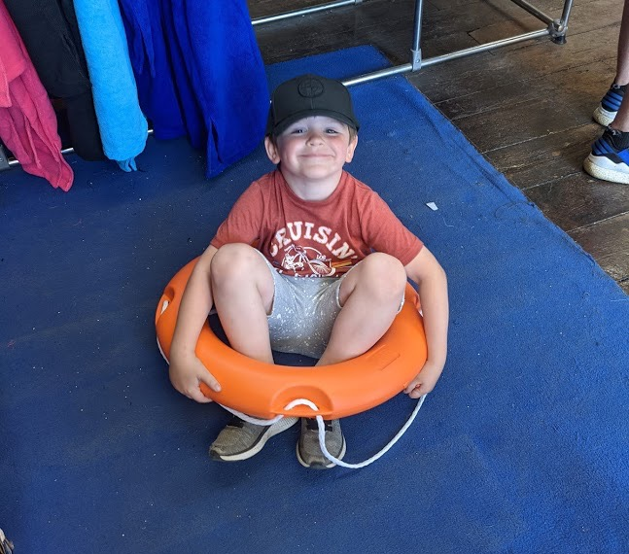

Slide 27
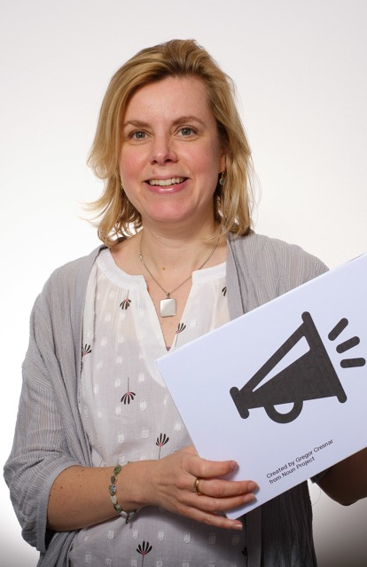
Thank you
Any questions?
@jsecker
Jane.Secker@city.ac.uk
informationliteracy.org.uk

Slide 28
References
Brown, B (2018) Dare to Lead. London: Vermillion
CILIP Definition of Information Literacy (2018) Available at https://infolit.org.uk/new-il-definition/
Digital Literacy and Open Practice course. Available at: https://blogs.city.ac.uk/dilop/
Kahneman, D (2011) Thinking, Fast and Slow. Penguin: London
Levitin, D (2014) The Organized Mind: Thinking Straight in the Age of Information Overload. Penguin: London
Secker, J and Coonan, E (2013) Rethinking Information Literacy: a practical framework for supporting teaching. Facet publishing: London.
Secker, J. (2018). The trouble with terminology: rehabilitating and rethinking ‘Digital Literacy'. In: Reedy, K. and Parker, J. (Eds.), Digital Literacy Unpacked. (pp. 3-16). London: Facet Publishing. ISBN 178330197X Available at: http://openaccess.city.ac.uk/20546/
Secker, J. (2020). Understanding the role of technology in academic practice through a lens of openness. In: INTED2020 Proceedings. (pp. 5363-5368). Valencia, Spain: IATED. ISBN 978-84-09-17939-8
Weiss, Carol (1995). Nothing as Practical as Good Theory: Exploring Theory-Based Evaluation for Comprehensive Community Initiatives for Children and Families in ‘New Approaches to Evaluating Community Initiatives’. Aspen Institute.
Zurkowski, P. (1974) The Information Service Environment: Relationships and Priorities. Related Paper No.5. National Commission on Libraries and Information Science. Available at: https://eric.ed.gov/?id=ED100391

