Slide 1

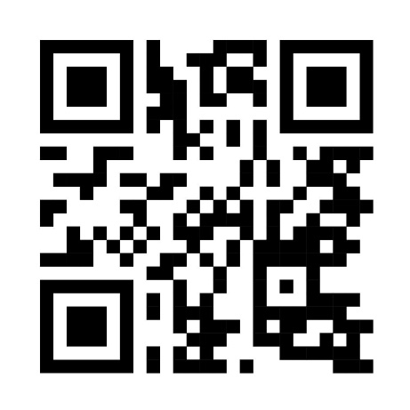


Safe Efficient and Enjoyable Mealtimes (SEEM Study): Creating a toolkit for families of children who need assistance with eating and drinking
– a multi-method investigation
Morgan, S.¹,​ Mulligan, K.^{1,2}, Weir, K. A.³, Hilari, K.¹
¹City, University of London, UK, ²East London NHS Foundation Trust, UK, ³University of Melbourne
Sally.morgan.2@city.ac.uk @sallymorganslt
Introduction & Aim
Children with neurodisability and oropharyngeal dysphagia have an increased risk of premature death^{1,2}
While awaiting new interventions caregivers need to maximise safety, efficiency & enjoyment for every mealtime
This study will create a toolkit for families of children who need assistance with eating and drinking
Methods
Research Evidence Study 1: Systematic Review
Clinical Expertise Study 2: SLT Practice Survey
Patient Values & Preferences Study 3: Qualitative mealtime study
Study 4: Co-creation of toolkit
Evidence Based Practice³ & MRC complex intervention development⁴ approaches used
To learn more, scan the QR code or contact to be added to SEEM Study mailing list
City, University of London
Northampton Square
London
EC1V 0HB
United Kingdom
T: +44 (0)20 7040 5060
E: department@city.ac.uk
Results (further data collection & analysis ongoing)
Study 1: Registered with Prospero. 25 included studies with updated search & screening underway.
Submission for publication March 2024.
Study 2: Survey open summer 2021. Covid-19 adaptations article published.
Main survey article submission for publication May 2024.
Study 3: NHS ethics, HRA and local Trust approvals in place. Recruitment underway & closes 31st March 2024.
Study 4: To be completed in 2025.
Conclusions
References
There is no current toolkit to guide creating mealtime recommendations with families.
The toolkit will include:
  What to change
  Barriers to making a change
  How to overcome those barriers
1. Heslop, P. et al. 2013. Confidential Inquiry into premature deaths of people with learning disabilities.
2. Perez, C.M. et al. 2015. The incidence of healthcare use, ill health and mortality in adults with intellectual disabilities and mealtime support needs. J. of Int. Dis. Research, 59(7), pp.638-652.
3. Sackett DL, Rosenberg WM, Gray JM, Haynes RB, Richardson WS. Evidence based medicine: what it is and what it isn't. Bmj. 1996 Jan 13;312(7023):71-2.
4. Skivington K, Matthews L, Simpson SA, Craig P, Baird J, Blazeby JM, Boyd KA, Craig N, French DP, McIntosh E, Petticrew M. A new framework for developing and evaluating complex interventions: update of Medical Research Council guidance. Bmj. 2021 Sep 30;374.

