Slide 1









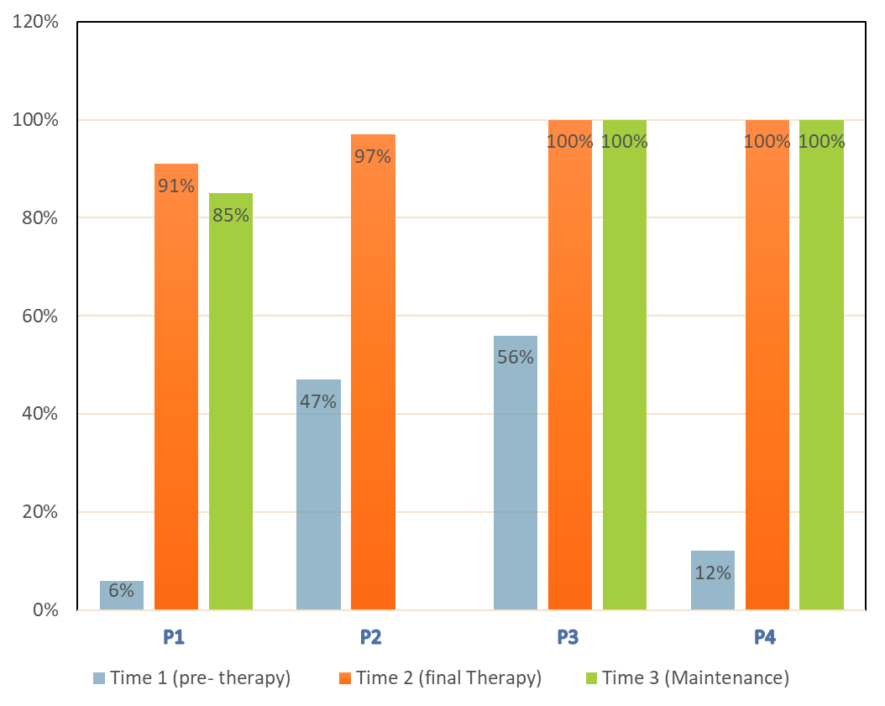




Is Strategies and measurable interaction in ‘Live English’ (smiLEtherapy™) feasible, acceptable and can it support communication development for teenagers with Down Syndrome?
Karin Schamroth¹, Emily Anning², Joanna Jakubowicz²,
Sophie Rowlands², Abi Saxby², Sally Morgan²
Sally.morgan@city.ac.uk @sallymorganslt
1: smiLEtherapy™ 2: City, University of London
Introduction
Methods
What is smiLEtherapy™?
What happens in smiLEtherapy™?
Group intervention (10 weeks)
Real Task:
Request item in office from stranger
Video before (wk1), after (wk10)
& maintenance (5 months)
Role play, dynamic group process,
self-evaluating videos
Parent Training Workshops
Service evaluation
Ethical approval granted:
SHS Ethics Committee, City, University of London
Data collection: n=data amount per participant
  YP participant videos: n=3
  YP participant Communication Skills Checklists: n=3
  YP participant feedback video: n=2
  Parent participant group videos: n=3
  Parent participant feedback survey: n=1
Data :
Descriptive statistics
Directed content analysis
Developed for Deaf teenagers and children
Now with other young people (YP)
Builds communicative and social skills resilience for everyday encounters in the community
Parent training integral
Research evidence for smiLEtherapy™ emerging^{1,2}
Research evidence for communication interventions for teenagers with Down Syndrome limited³
Questions
Feasible?
Acceptable?
Skill change & maintenance?
Results
All parents gave consent for the service evaluation data sharing
YP videos: Communication Skills Checklist scores
4 teenagers
4 parents
Parents reported:
Skills
Confidence
(teenager & self)
City, University of London
Northampton Square
London
EC1V 0HB
United Kingdom
T: +44 (0)20 7040 5060
E: department@city.ac.uk
“He did learn how to do it … because he watched everybody else. It was important…being able to watch everybody” (PP1)
“We want them to be as independent as possible ..We just needed this for you to kind of guide us” (PP2)
Missing data:
1 x Parents video (did not record)
1 x YP participant post-intervention video (declined, used most recent intervention practice video)
1 x YP participant maintenance session video (did not attend)
2 x YP feedback videos (declined)
Conclusions
References
Feasible
Acceptable
Teenagers’ skills improved & maintained
Need to explore reported generalisation
Schamroth, K. and Lawlor, 2017. Smile therapy: Functional communication and social skills for Deaf students and students with special needs.
Alton et al., 2011. Developing communication skills in deaf primary school pupils: Introducing and evaluating the smiLE approach. Child Language Teaching and Therapy, 27(3),
Smith et al., 2020 Children with Down syndrome can benefit from language interventions; Results from a systematic review and meta-analysis. Journal of Communication Disorders.
CONTACT:
Sally Morgan
City, University of London
School of Health & Psychological Sciences
Northampton Square
London EC1V 0HB

